Slide 1


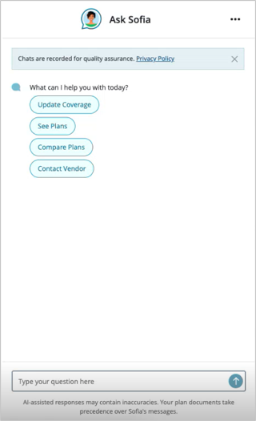
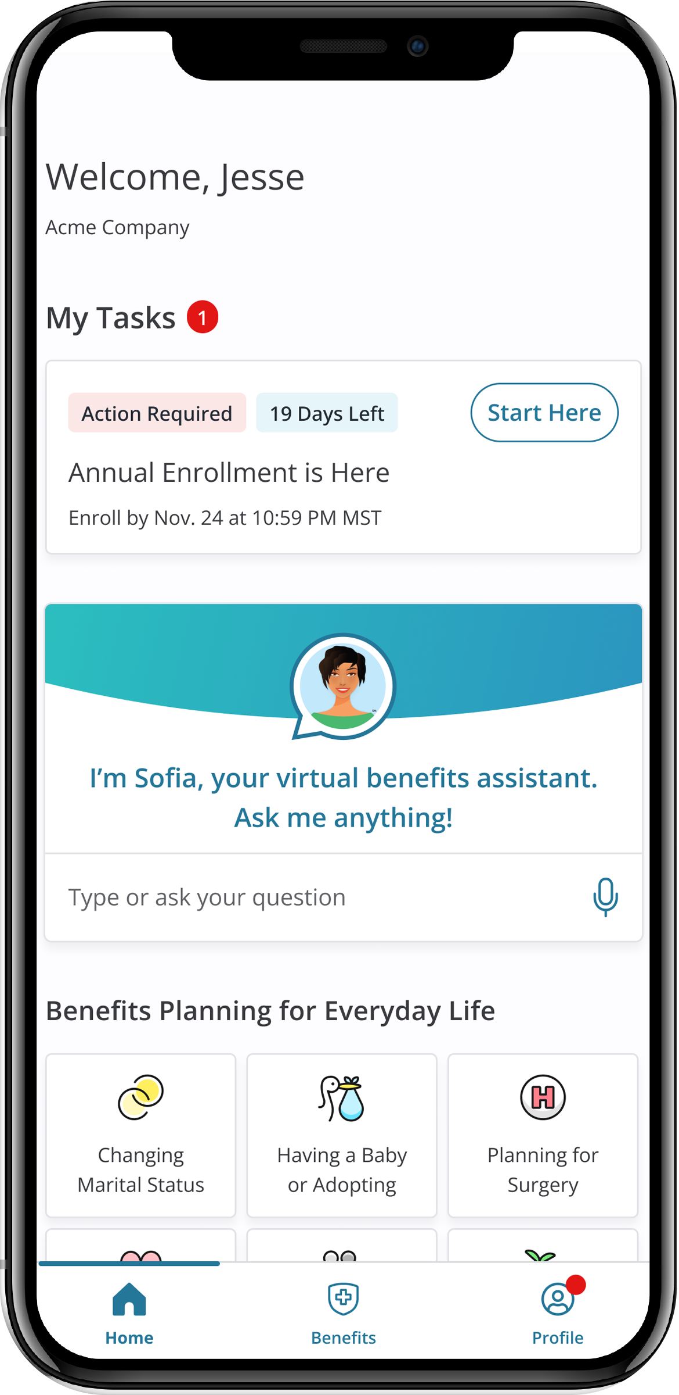
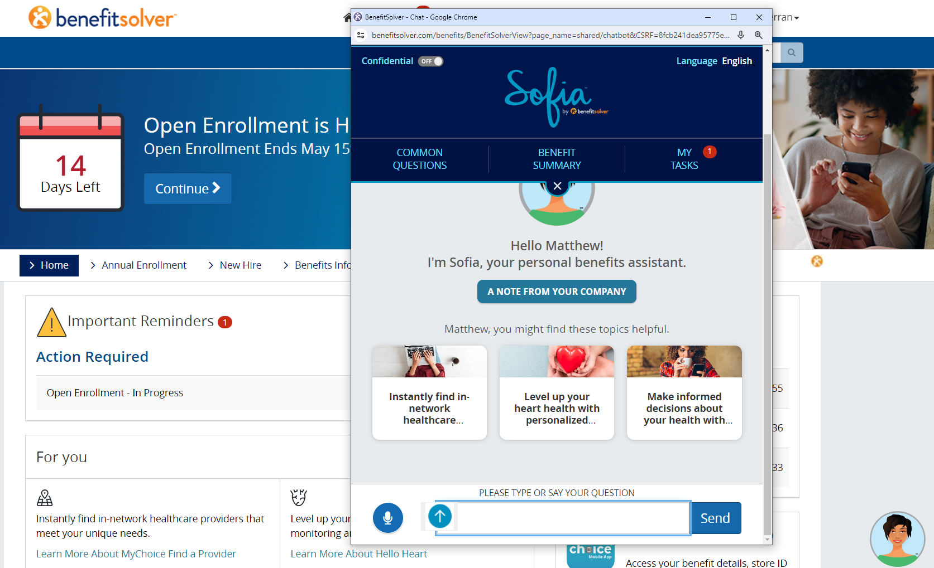
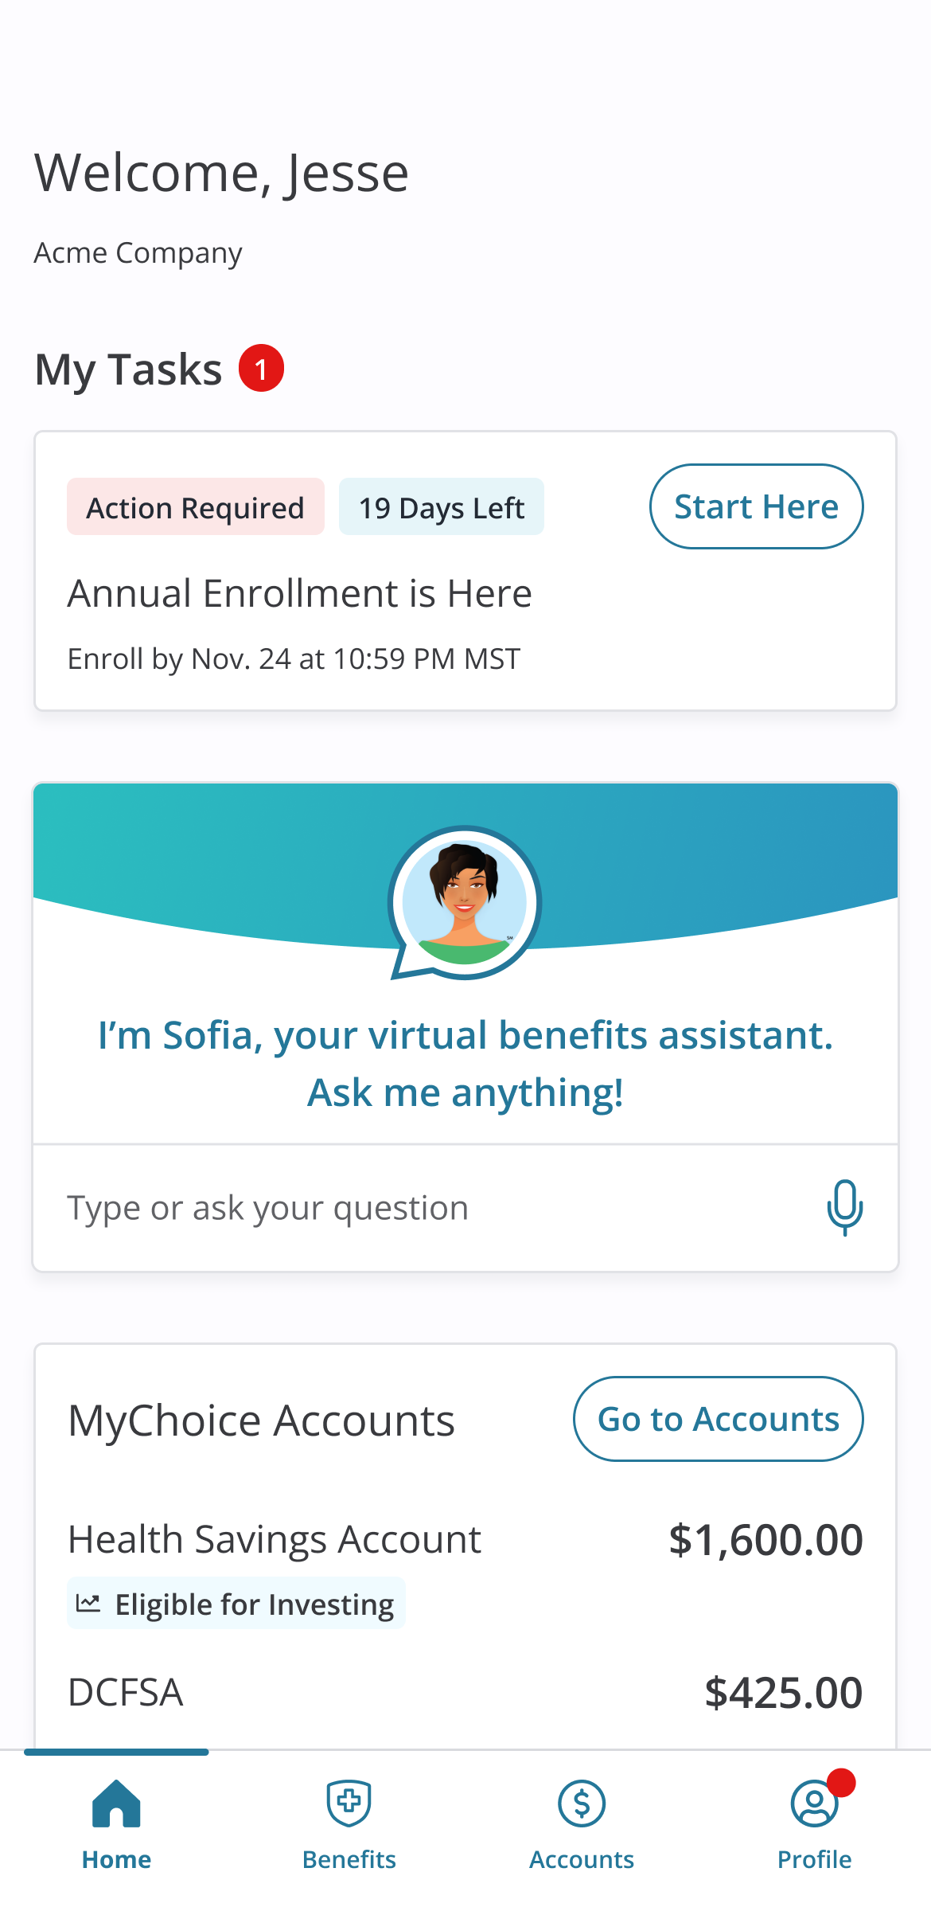
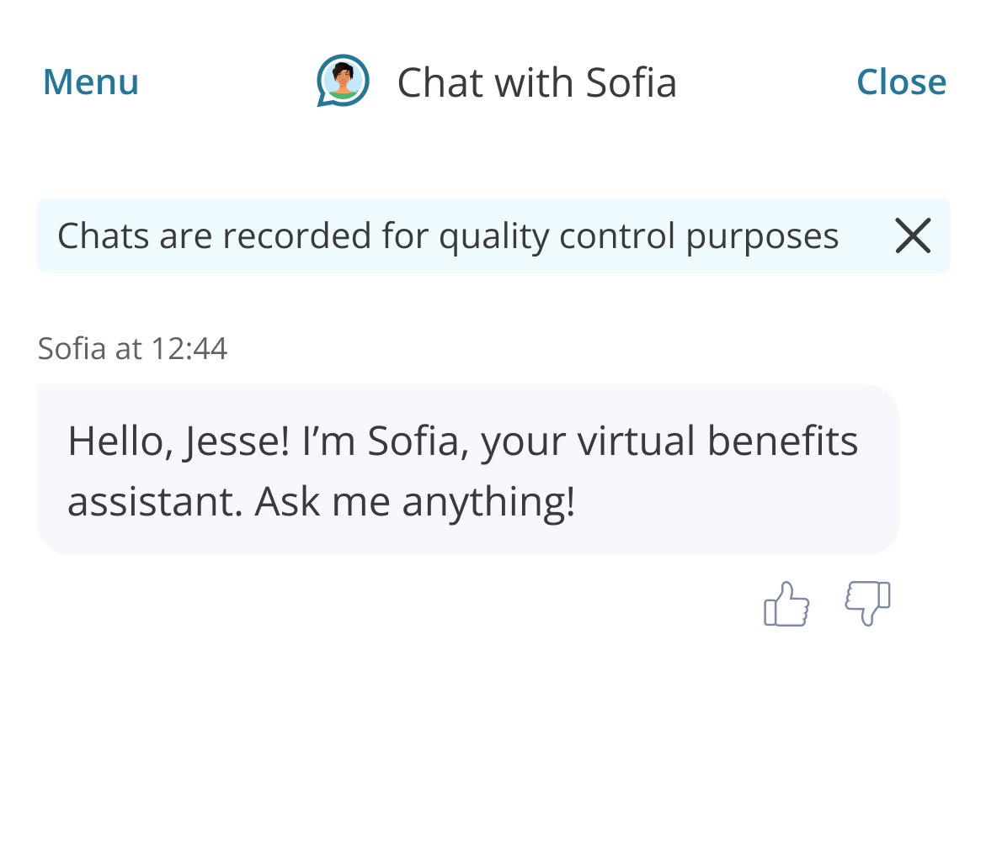
Sofia
SM
Your personal benefits assistant
is standing by to answer your
benefits questions.
Sofia uses machine learning to assist you in
your needs which means she learns from every
interaction and grows her knowledge over time!
How Can I Use Sofia?
Simply click on the Sofia icon in the bottom right corner
and ask your question. You can chat with her by typing your questions or using the microphone feature.
Sofia is available to you 24/7, every day of the week. She also speaks multiple languages, just select that option right at the start.
What Can Sofia Answer?
Plan details
Vendor contact information
Verification status
Benefits information
HSA/FSA balances (remove if not MCA client with HSA/FSA)
And much more!
Hi!
I’m Sofia..

