Slide 1
How to use this presentation
This presentation is designed to help HR leaders explain the key features of the spending and/or savings accounts offered to them by your organization.
This file is meant to be your template. There are items marked in yellow that might be specific to your organization’s plan design. Simply fill those in or remove them altogether and remove the highlighting for the final presentation.
There are a few red box notes to help you get the right information in your presentation. Determine which slides you need and delete the red box notes.
Use only the slides that align with your organization’s account types. If you do not have dependent care FSAs, just delete those slides.
For HSA, to simplify the presentation, you may remove the “SAVE” and “INVEST” sections.
There are explainer videos for each account type. Feel free to click on the graphic to play those or remove them from the presentation. You may have to “enable content” as these are linked within the presentation.

Slide 2
[Client Name] Benefits
Pre-tax Spending/Savings Accounts

Slide 3
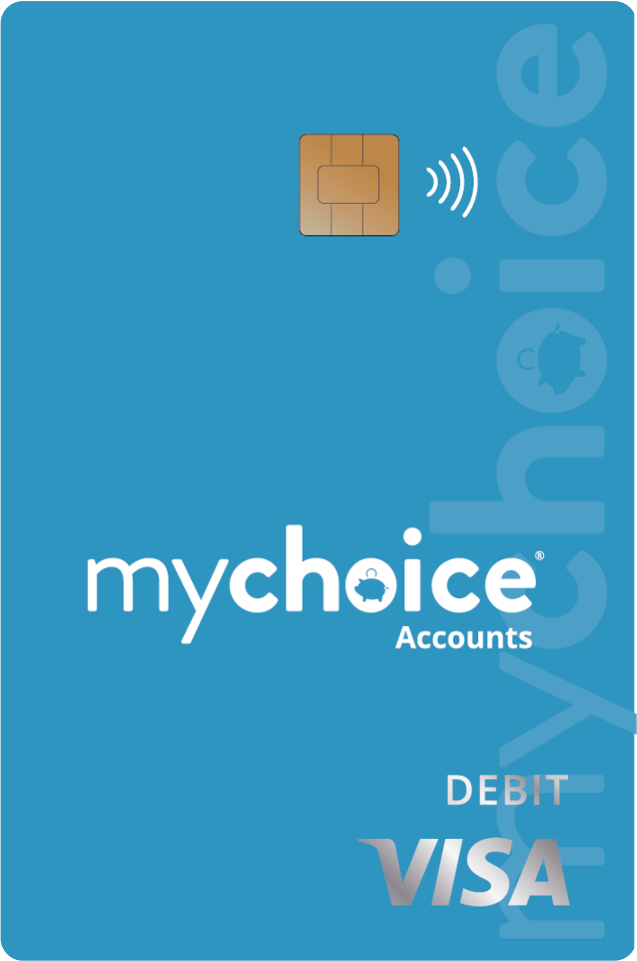
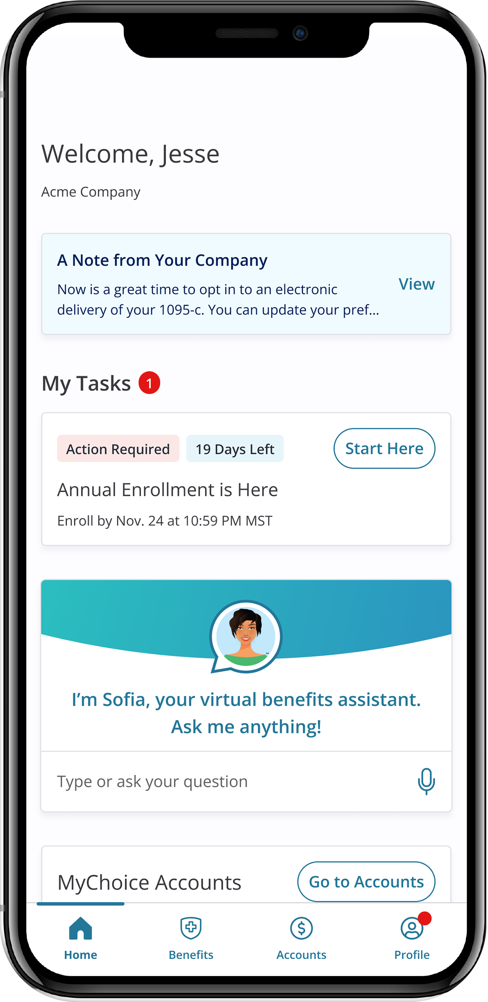
Who We Are
MyChoice Accounts is your administrator for your health care flexible spending account (FSA), the dependent care FSA (DCFSA), and the health savings account (HSA).
Access these accounts in your Benefitsolver system either online or via the MyChoice®️ benefits app, where you enroll in all your benefits.
Notes:
MyChoice Accounts, powered by Businessolver, will be the administrator of the Health Care FSA and Dependent Care Account Plan.
With MyChoice Accounts, it is easy to use your account. All participants will have access to an online portal, mobile app as well a payment card if you enroll in the {{account types}}. The card will give you quick and easy access to your account funds. This is the logo for MyChoice Accounts that you will see on communications and this is what your debit card will look like.

Slide 4
What Do These Accounts Cover?

Slide 5
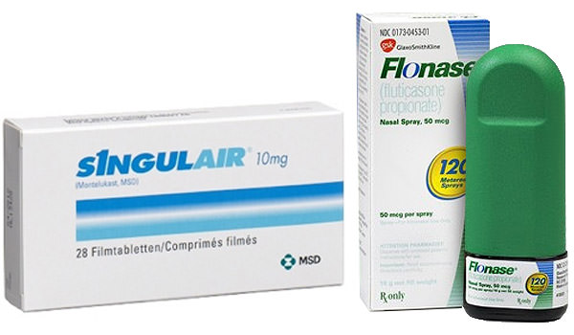
Think About What You Already Cover Out-of-Pocket…
…add it up and know you can cover these with a health care FSA or HSA
Notes:
So, to prepare for enrolling in an FSA account or HSA account it is a good idea to estimate how much you might spend every year on your medical, dental, vision, prescriptions as well as items you buy over the counter such as pain medicine like Advil or Tylenol in the picture, sun screen and even allergy medicine. Again, think about things like upcoming surgeries…or even if your child needs braces or other orthodontic work.
All of these items are covered with the Health Care FSA and the Health Savings Account, or HSA. So, you will be setting aside your money and saving that 20-30% in taxes every time you need to pay for something like this.
Did you know that the average American family spends about $1,600 in eligible healthcare expenses every year? You may as well do that tax-free with an FSA or HSA.

Slide 6
Some of the Hundreds of “Eligible” Expenses:
MEDICAL, DENTAL, VISION, PRESCRIPTION + MORE
Allergy Medicine
Blood Pressure Monitoring
Braces
Breast Pump
Contact Lenses
Copayments (Medical and Prescription)
Deductible
Dental Treatment
Durable Medical Equipment (walkers, crutches, and more)
Feminine Care Items
Fertility Treatment
Hearing Aids
Insulin and Diabetic Supplies
Laser Eye Surgery
Over-the-counter (OTC) treatments
Pain Medications
Sunscreen
For even more items—go to mychoiceaccounts.com
Notes:
So as you have heard and seen so far, There are hundreds of uses for your FSA and HSA funds, including medical, dental, vision, and prescription expenses for you, your spouse or your dependents. Here is a sample list of qualified expenses, as deemed by the IRS.
It’s also important to know what expenses are not qualified as well. Examples of some non eligible expenses would be cosmetic procedures, gym memberships, and teeth whiting. More details on eligible and non eligible items are available at your benefits portal.

Slide 7
Health Care FSA

Slide 8
What is a Health Care FSA? Video
Notes:
(in presentation mode, select the video to play video)
Link if video does not play as expected:
https://vimeo.com/455910435/8cea6913ad

Slide 9
What is an FSA?
For members enrolled in the PPO option.
A Health Care Flexible Spending Account (FSA) is an account that allows you to use pre-tax dollars to pay for health care expenses, like medical, dental, vision and prescription expenses.
Account Advantages
Tax savings
Multiple uses
Easy to access
Mobile and online access
Member service support
FSAs can help your
budget go further
by using pre-tax funds
for everyday expenses.
Notes:
The Health Care Flexible Spending account or “FSA” helps you save money through pre-tax payroll contributions. These accounts will let you save on expenses you already have today!
First, we are going to cover some of the important details about the health care FSA.
The FSA pairs with our PPO health plan option (insert more detail if needed).
You never pay taxes on the funds you set aside, and the FSA is easy to spend with your debit card—at the doctor’s office, dentist, pharmacy, eye doctor, and stores.

Slide 10
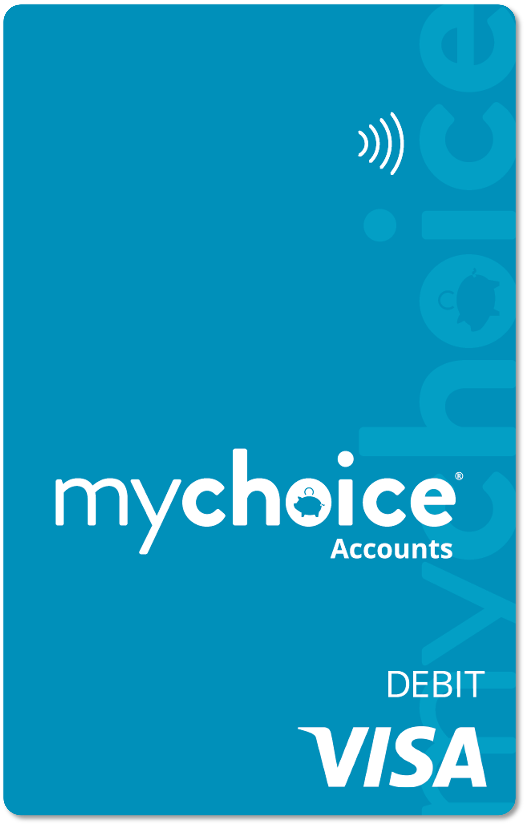
How does a Health Care FSA work?
A Health Care Flexible Spending Account is a tax-advantaged account that allows you to use pre-tax dollars to pay for medical, dental, vision prescription, and some over-the-counter items.
Contributions
You decide how much to contribute to your account up to the IRS limit.
Maximum annual contributions for Health Care FSA: $3,200.
If your spouse has access to an FSA, they may contribute the maximum amount too.
Contributions are tax free and processed through payroll in equal deductions throughout the year.
Notes:
When you enroll, you’ll choose how much money you want to contribute to the FSA, and you will have access to the full amount you elect for Health Care FSA on Jan 1st, 2023.
Currently, Healthcare FSA contributions are limited by the IRS to $3,200 each year.
The limit is per person; each spouse may contribute up to the limit if you both are employees of [CLIENT NAME] or if your spouse has access to a Healthcare FSA with another employer.
You can only elect the health care FSA during your annual enrollment period – so for example you can’t decide next June to start one up unless you have a life event such as a birth, marriage or divorce.

Slide 11
How does a Health Care FSA work?
Using Your Account
Use the funds for your qualified expenses for you and your family (spouse, eligible dependents).
Total health care FSA election for the year are available when your plan becomes effective on January 1.
Notes:
A simple overview of using your account is that you can use the funds for medical expenses for you and your family – that includes your spouse and eligible dependents… those are dependents that you claim on your tax returns.
Another great feature of the health care FSA is that all of the money you elect for the whole year is available to you on January 1. It’s essentially an advance of your election. You’ll contribute money throughout the year, but you don’t have to wait on those contributions to get access to that full amount you choose. If you have an emergency in January, you have it covered, depending on how much you elect.

Slide 12
What Happens if I Don’t Use All My Money?
Health Care FSA Funds Grace Period
Your FSA comes equipped with a grace period, meaning you have until March 15 of next year, to exhaust your current plan year’s election.
Spend your entire election between January 1, 2025 – March 15, 2026.
Presenter note: Choose either slide 12 (grace period) or 13 (roll over) depending on your plan design. Hide or delete the one you don’t need. Remove this text box.
Notes:
Your FSA comes with a grace period. That means you get about 2 and a half extra months to use up the prior year’s funds. So, in all, you will get 14 and a half months to use your 2023 FSA amount. You will want to spend it ALL down within that time frame. Anything you don’t spend will go back into the plan administration. This is an IRS provision.
Both your online account and your mobile account will help remind you of your claims submissions and funds use deadlines.

Slide 13
What Happens if I Don’t Use All My Money?
Health Care FSA Funds Rollover
Your FSA allows you to “roll over” up to $640 annually.
Spend down your balance to at least $640 or less by December 31, 2025.
Presenter note: Choose either slide 12 (grace period) or 13 (roll over) depending on your plan design. Hide or delete the one you don’t need. Put in your rollover amount where indicated. Remove this text box.
Notes:
Your FSA comes with a rollover feature. That means you get to roll over or carry over up to $640 into the following year’s FSA. So, you’ll want to make sure you spend down your balance to at least $640 or less by the end of the year. The rollover funds will be added to your 2025 FSA. You get a maximum of $640 each year to roll over.

Slide 14
Why Enroll? Savings, savings, savings!
How it works: Assume “Melissa” earns $35,000 a year and has $1,500 in eligible expenses.
 | No FSA | With FSA
Annual Pay | $35,000 | $35,000
Pre-tax FSA Contribution | -$0 | -$1,500
Taxable Income | =$35,000 | =$33,500
Federal income and Social Security Taxes | -$7,852 | -$7,362
After-tax dollars spent on eligible expenses | -$1,500 | -$0
Spendable income | =$25,648 | =$26,138
Melissa’s Tax Savings | $0 | $490
*Sample tax savings for a single taxpayer with no dependents; actual savings will vary based on your individual tax situation. Consult a tax professional for more information. This FSA Savings calculator was created by MyChoice Accounts to be illustrative of typical results of typical participants in similar type benefits programs. The accuracy of the results are predicated upon the input provided by the user, and as such, MyChoice Accounts disclaims the accuracy of any results shown. This calculator is intended merely as a planning tool and is not meant as tax or investment advice. Before taking any action based upon the results provided, please consult with a tax consultant or expert.
Notes:
Health Care FSAs can cover medical, dental, vision, prescription and over the counter expenses that you would otherwise pay for using personal funds--potentially saving you hundreds of dollars each year in taxes.
In this example, Melissa contributed $1,500 to her health care FSA. Because her contributions are taken out pre-tax, she does not pay taxes on the money contributed to her FSA, saving her close to $500 this year!
On the left it shows that she was going to spend $1,500 on health care services and items during the year either way. On the right in purple, we see that by setting aside that money in an FSA, she saved nearly $500 because she did not pay taxes on that money.
You’ll also find that FSAs are especially useful when planning for large health care expenses-- like having a baby, getting braces or having laser eye surgery.
We have a calculator that you can complete to see what YOUR savings could be. We’ll have a link to that on our website at mychoiceaccounts.com. Most people are going to find at least a few hundred dollars in savings…that savings can go a long way toward something else.

Slide 15
Health Savings Account - HSA

Slide 16
What is an HSA? Video
Notes:
(play video)
Link if video does not play as expected:
https://vimeo.com/462397664/e30d775960

Slide 17
What is an HSA?
For members enrolled in the HDHP – High Deductible Health Plan
A Health Savings Account (HSA) is an account that allows you to use pre-tax dollars to pay for health care expenses, like medical, dental, vision and prescription expenses. Think of it as a way to cover your deductible and as long-term savings.
Account Advantages
HSAs never “expire”
HSAs are “portable”
Tax savings
Multiple uses
Invest funds for growth
Easy to access
Mobile and online access
Member service support
DEDUCTIBLE $
MEDICAL EMERGENCY or RETIREMENT SAVINGS
Notes:
A Health Savings Account (HSA) is an account that allows you to use pre-tax dollars to pay for health care expenses, like medical, dental, vision and prescription expenses. Think of it as a way to cover your deductible and as long-term savings.
Account Advantages
HSAs never “expire” – unlike an FSA, which you may also be familiar with, HSAs are NOT “use it or lose it.” They roll over year to year.
HSAs are “portable” – HSAs are your personal savings account, so even if you depart from the organization, you still own the funds and can spend them on eligible services and items.
Tax savings – you set aside your HSA funds pre-tax, and you are not taxed when you spend your funds.
Multiple uses – HSAs can be used for doctor and dental visits, orthodontics, vision expenses, prescriptions, over the counter remedies, and many more uses.
Easy to access -- it’s easy to spend your funds when you need to with your MyChoice Accounts VISA debit card.
Mobile and online access – you can always check your balance and manage your account in your benefits website or the MyChoice benefits app.
Member service support –if you have questions or concerns, you have a member services number to call.

Slide 18
HSA Contributions
You decide how much to contribute to your account up to the IRS limit.
Maximum annual contributions for HSA 2025:
$4,300/year filing single
$8,550/year filing jointly
Contributions are tax free and processed through payroll in equal deductions throughout the year. You can change your election amount at any time.
FREE MONEY: [CLIENT NAME] contributes to the HSA in January and July. $600/single/year; $1,200/family/year
Notes:
ITEMS IN RED ARE CONFIGURABLE AT THE CLIENT LEVEL!
You decide how much to contribute to your account up to the IRS limit.
Maximum annual contributions for HSA 2025:
$4,300/year filing single
$8,550/year filing jointly
Contributions are tax free and processed through payroll in equal deductions throughout the year. You can change your election amount at any time.

Slide 19
How does an HSA work?
Using Your Account
Use the funds for your qualified expenses for you and your family (spouse, eligible dependents).
Key differences from FSA:
Option to save and NOT SPEND.
No expiration date.
No receipts or documentation needed (save them for the IRS).
Your savings account “for life” – even if you separate from employer.
Funds available as you make contributions through payroll – you can only spend what you’ve already set aside.
Invest contributions to grow your $ faster.
Open an HSA at any time or change contributions at any time in the year.
Notes:
Using Your Account
Use the funds for your qualified expenses for you and your family (spouse, eligible dependents)
Key differences from FSA:
Option to save and NOT SPEND – you can save and accrue your funds year over year if you don’t need them to pay health care expenses.
No expiration date.
No receipts or documentation needed (save them for the IRS).
Your savings account “for life” – even if you separate from employer.
Funds available as you make contributions through payroll – you can only spend what you’ve already set aside.
Invest contributions to grow your $ faster.
Open an HSA at any time or change contributions at any time in the year.

Slide 20
What can I do with my HSA?
SAVE
INVEST
SPEND
Notes:
HSAs can help your health care budget go further. Think about it as having three functions. Save, invest, or spend. We put SPEND last because you’ll actually get the most value out of your HSA if you save or invest it. But the good news is, if you need the funds for a health care expense, it is available to spend. So let’s look at each of these functions and find out how to maximize your HSA.

Slide 21
SAVE your HSA

Slide 22
The S is for Savings
HSAs GROW!
Your HSA funds never “expire.”
HSAs have a small percentage of growth just like a savings account.
You can hold your HSA funds year over year.
If you leave your current employer, your HSA goes “with you.”
You may roll over funds to a new employer’s HSA or continue to hold or spend your HSA funds on eligible expenses.
Notes:
This is a savings account, again, as opposed to an FSA, which is designed to SPEND. HSAs are most effective when you let them build over time. We’ll get to what to do when you need to use the funds in a few minutes, but we started with savings because we’d love for you to think of your HSA primarily as a savings tool.
Your HSA funds never “expire.”
HSAs have a small percentage of growth just like a savings account.
You can hold your HSA funds year over year.
If you leave your current employer, your HSA goes “with you.”
You may roll over funds to a new employer’s HSA or continue to hold or spend your HSA funds on eligible expenses.

Slide 23
The S is for Savings
If possible, think of your HSA as one of your retirement accounts that you can use before retirement if needed.
WHY?
Notes:
If possible, think of your HSA as one of your retirement accounts that you can use before retirement if needed.
WHY?

Slide 24
Cost of Health Care in Retirement
An average retired couple age 65 in 2023 may need approximately $315,000 saved (after tax) to cover health care expenses in retirement.
~ Fidelity Retiree Health Care Cost Estimate
Notes:
Some of you may be 25 years away from retirement and feeling the pinch of inflation right now. Why consider your HSA as a long term savings? One thing we know is that health care expenses continue to increase year over year. Having some tax-free savings to help cover these costs is just as smart as putting money away in a 401(k).
People don’t tend to get healthier as they age. They will tend to need more care, and Medicare doesn’t cover everything. You can use your HSA to cover that gap between Medicare and additional Medicare options, and other health care expenses in retirement.

Slide 25
Nest Egg
Ming sets aside the $5,000 per year in her HSA, using about $1,000 annually for various medical expenses. She starts contributing at age 32 and invests the money she’s not actively using. Assuming a $400/year employer contribution.
Age 65
$167,835
$4000/year savings at
.1% interest growth
$5,000 over 26 paychecks = $192.30 per check
Age 50
$90,859
Age 42
$50,275
Notes:
Again, this is a savings account, so it will grow with a very modest percentage of interest over time. We have our sample member here who contributes $5,000 a year for her family HSA. She could contribute up to $8,550 a year in 2025, and those contribution upper limits will continue to grow, but let’s say she feels comfortable at just under $200 per paycheck.
We see that if she saves and contributes consistently, spending only about $1,000 per year on average, she still has about $167,000 upon retirement.
To reconfigure this chart based on an employer’s contribution, go to:
https://hsastore.com/hsa-tax-savings-calculator?a_aid=5bf468aa5c776&utm_source=Businessolver&utm_medium=TPA+Public+Link+Cal&utm_campaign=TPA+Partner

Slide 26
INVEST your HSA
Notes:
Here’s where you really start to see people drop out, so hang with me. Your HSA also comes with a special feature that FSAs definitely don’t have. Investments…

Slide 27
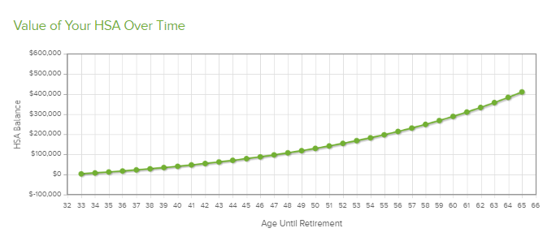
Invest, and that nest egg really grows!
Ming sets aside the $5,000 per year in her HSA, using about $1,000 annually for various medical expenses. She starts contributing at age 32 and invests the money she’s not actively using. Assuming a $400/year employer contribution.
Age 65
$454,009
$4000/year savings at
6% investment growth
$5,000 over 26 paychecks = $192.30 per check
Age 50
$144,145
Age 42
$61,475
Notes:
Looking at the exact same set-up here, Ming is still contributing about $5,000 a year for her family HSA. With a modest 6% growth, and that same contribution rate of just under $200 per pay period…Ming can have more than $567,000 available when she turns 65. Let’s look at that difference more closely…
To reconfigure this chart based on an employer’s contribution, go to:
https://hsastore.com/hsa-tax-savings-calculator?a_aid=5bf468aa5c776&utm_source=Businessolver&utm_medium=TPA+Public+Link+Cal&utm_campaign=TPA+Partner

Slide 28
Which one works better?
Age 65
Saving only: $167,835
Age 65
Investing:
$454,009
Investing =
$286,174 more!
Notes:
So looking at the savings-only method, there’s nothing wrong with setting aside more than $160,000 for health care costs. That’s still a great savings.
But when you compare it to the investing balance that Ming COULD attain, it’s a huge difference.
Of course, we have to disclaimer a bit, saying that we obviously don’t control the stock market, and some stocks are going to grow more than others.
However, the investment options we provide is a very curated and narrow list that’s been selected for relatively good returns. You can review all the specifications for each investment option and look at the rate of return over 5 and 10 year when you’re selecting your investments.

Slide 29
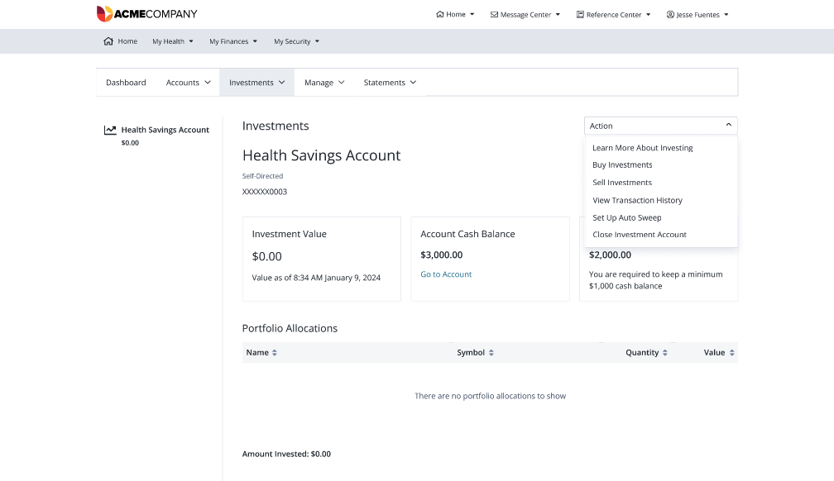
Investing is Easy
Notes:
Sometimes people are intimidated by investing. You do not need a finance degree or special skills to invest your funds. Once you have at least $1,000 in your account, you can begin investing. Then, we’d recommend keeping about $1,000 free for unexpected expenses. So, keep about $1,000 uninvested and ready to use if you need to make an ER payment or buy a prescription. There is a button on your MyChoice Accounts HSA that will take you into the investing options. MyChoice Accounts cannot provide you with financial advice, but if you get stuck in this process, we can help you navigate the screens.

Slide 30
SPEND your HSA
Notes:
And finally, you can spend that HSA. Sometimes you need to cover medical costs – unexpected expenses or large out-of-pocket costs like braces or physical therapy. Or if your budget gets tight, the HSA is there to help you cover costs.

Slide 31
Think About What You Already Cover Out-of-Pocket…
…these are all eligible with HSA funds.
Notes:
HSAs cover medical, dental, vision, prescriptions as well as items you buy over the counter such as pain medicine like Advil or Tylenol in the picture, sun screen and even allergy medicine. Again, Think about things like upcoming surgeries…or even if your child needs braces or other orthodontic work.
All of these items are covered with your HSA. So, you will be setting aside your money and saving that 20-30% in taxes every time you need to pay for something like this.

Slide 32
Some of the Hundreds of “Eligible” Expenses: MEDICAL, DENTAL, VISION, PRESCRIPTION + MORE
Allergy Medicine
Blood Pressure Monitoring
Braces
Breast Pump
Contact Lenses
Copayments (Medical and Prescription)
Deductible
Dental Treatment
Durable Medical Equipment (walkers, crutches, and more)
Feminine Care Items
Fertility Treatment
Hearing Aids
Insulin and Diabetic Supplies
Laser Eye Surgery
Over-the-counter (OTC) treatments
Pain Medications
Sunscreen
For even more items—go to mychoiceaccounts.com
Notes:
So as you have heard and seen so far, There are hundreds of uses for your HSA funds, including medical, dental, vision, and prescription expenses for you, your spouse or your dependents. Here is a sample list of qualified expenses, as deemed by the IRS.
It’s also important to know what expenses are not qualified as well. Examples of some non eligible expenses would be cosmetic procedures, gym memberships, and teeth whiting. More details on eligible and non eligible items are available at your benefits portal.
It is your responsibility to know what’s eligible and what’s not, as your HSA does not require receipts. You are essentially attesting that you are using it as intended when you make a transaction. It is advised to keep receipts in case you are audited by the IRS.

Slide 33
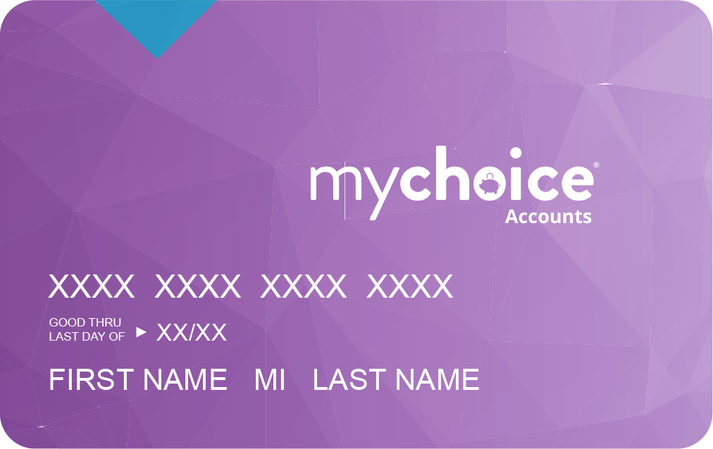
How do I spend my HSA?
Use your MyChoice Accounts debit card on eligible expenses.
Many stores have medicine, supplies, and other eligible items marked on the price tag.
YOU are responsible for purchasing eligible items. The IRS does not require MyChoice Accounts to verify your HSA spending.
File or take a photo of your receipt for your own safekeeping.
No need to submit receipts or documentation for an HSA.
Notes:
Use your MyChoice Accounts debit card on eligible expenses.
Many stores have medicine, supplies, and other eligible items marked on the price tag.
YOU are responsible for purchasing eligible items. The IRS does not require MyChoice Accounts to verify your HSA spending.
File or take a photo of your receipt for your own safekeeping.
No need to submit receipts or documentation for an HSA.

Slide 34
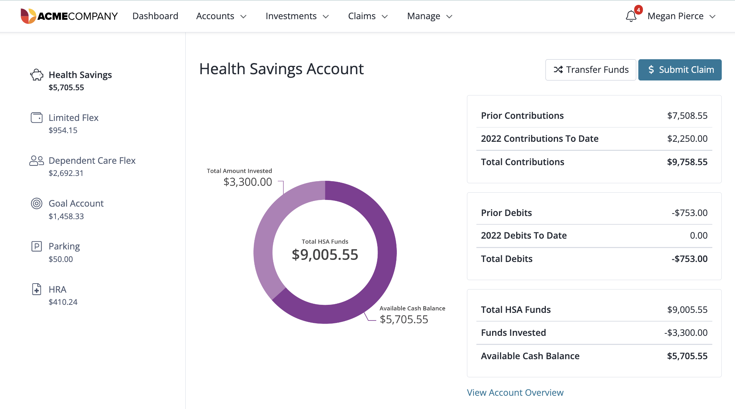
What if I don’t have my card?
You can transfer your HSA funds to your personal bank account or submit claim to receive a paper check when you spend your HSA funds on eligible items and services.
Notes:
If you don’t have your card handy when you need to pay at the provider’s office or store, you can transfer your HSA funds to your personal bank account when you spend them on eligible items and services.

Slide 35
Another way to spend…Limited Purpose FSA
DENTAL/VISION EXPENSES
If you enrolled in a Limited Purpose FSA, you can SPEND that and keep your HSA balance intact.
Make election during annual enrollment.
Spend down your balance or carry over up to $610/year.
Use the same debit card as your HAS.
SOME EMPLOYERS WILL OFFER THE LIMITED PURPOSE FSA. Remove this slide if you do not offer or remove this box to use this slide.
Notes:
If you enrolled in a Limited Purpose FSA, you can SPEND that and keep your HSA balance intact. You may only elect this account during annual enrollment each year.
If you have dental or vision expenses, this is a great way to set aside tax-free money. Just like a standard FSA, you’ll want to deplete the funds on an annual basis. If you have signed up for this, use your same debit card. The card is programmed to pull any dental or vision expenses from the limited purpose FSA first. And remember, you have access to your FULL FSA at the beginning of each year, so you can go ahead and purchase your contacts, glasses, or make orthodontist payments as early as January.

Slide 36
Dependent Care FSA

Slide 37
What is a Dependent Care FSA?
Notes:
(click graphic to play video)
Link if video does not play as expected: https://vimeo.com/463053043/21307266ce

Slide 38
What is a DCFSA Plan?
Contributions
You may contribute up to $5,000 to your account ($5,000 per calendar year if single or married filing jointly, $2,500 if married filing separately).
Contributions are tax free.
Using Your Account
Use the funds for child or dependent care while you are at work – typical expenses include day care, before and after school care.
Funds become available for use as you contribute them.
Funds Forfeiture
Unused amounts at year-end are NOT rolled over to the next plan year.
A DCFSA Plan is a tax-advantaged account that allows you to use pre-tax dollars to pay for eligible child and elder care while you work.
Notes:
Another type of account you may also choose is a Dependent Care Account Plan or “DCFSA,” This account covers dependent and elder care expenses – like daycare or elder nursing care while you work. You may elect up to $5,000 per year if you have these expenses. Just like the health care FSA, these contributions are all tax-free, which ultimately saves you 20-30% on your final cost of childcare.
Unfortunately, DCFSA funds do not roll over. Per IRS regulations, the rollover feature is limited to Health FSAs; Dependent Care FSA funds may not be rolled over and will expire on December 31 each year. Again, You may elect up to $5,000 per year.

Slide 39
Am I Eligible for This?
To be reimbursed through your Dependent Care Account Plan for child and dependent day care services, you must meet the following conditions:
The childcare or elder care costs must be for time that you or you and your spouse are working or looking for work, in full-time school, or if care if for an adult – the adult must be physically or mentally incapable of self-care.
You can’t use the DCFSA to pay someone who is your dependent on your federal tax return or to your child who is under age 19. For example, you cannot pay your oldest child to baby-sit your toddler and get reimbursed through this plan.
Notes:
There are some eligibility requirements.
The childcare or elder care costs must be for time that you or you and your spouse are working or looking for work, in full-time school, or if care is for an adult – the adult must be physically or mentally incapable of self-care.
You can’t use the DCFSA to pay someone who is your dependent on your federal tax return or to your child who is under age 19. For example, you cannot pay your oldest child to baby-sit your toddler and get reimbursed through this plan.

Slide 40
How Can I Use the DCFSA Plan?
Expenses for DCFSA Plan include
Before school or after school care (other than tuition expenses)
Licensed day care centers
Nursery schools or pre-schools
Placement fees for dependent care providers, such as au pairs
Childcare at a day camp, nursery school, or by a private sitter
Summer or holiday day camps
Late pick-up fees
Custodial care for dependent adults
Care of an incapacitated adult at least 8 hours a day, if adult lives with you
Notes:
Here is a list of qualified dependent care expenses. Included on this list are expenses such as Pre-school, day care, camps, as well as before and after school care.
Expenses that you CAN’T USE the DCFSA Plan for are: Expenses for children 13 and older, educational expenses like private school tuition, expenses for food, clothing, sports lessons, field trips as well as overnight camp expenses
It is important to know what is and what is not qualified. You can see in more details at your FSA enrollment website.

Slide 41
Paying for Care
Use your MyChoice Accounts debit card to pay qualified child or elder care providers.
Or pay out of pocket and get reimbursed.
Submit your claims or documentation online or through the MyChoice®️ benefits app.
Always submit your documentation for dependent care expenses, so we can approve them, per the IRS.
If you do offer a carded dependent care account, remove the first bullet point..

Slide 42
Commuter Benefits

Slide 43
What are commuter benefits?
Notes:
(click on the graphic to play video)
Video includes information about BOTH transit and parking options.
Link if the video does play as expected:
https://vimeo.com/467983925/d2d766ae2a

Slide 44
Commuter Benefits
Pre-tax Benefits for Parking and/or Transit
Set aside pre-tax funds for parking expenses (parking at or near your place of work).
Or Transit expenses, any toll or rider expense related to your commute to work that covers costs for:
Train
Subway/Metro
Bus
Ferry
Vanpool service, UberPool, Lyft Shared
Notes:
If you pay for parking at or near your office, you can set aside pre-tax funds to help you cover those expenses.
Also, you can save on gas money and help the planet by taking transit – which includes trains, buses, subway, ferry, a vanpool service or rideshare versions of UberPool or Lyft Shared (not a single rider Uber or Lyft).

Slide 45
How Do Commuter Benefits Work?
Set aside up to $315/month for parking, transit, or both.
Set aside what you think you will USE each month.
Use your MyChoice Accounts debit card to pay at parking kiosks or to purchase transit fare/passes or pay/reload on transit apps.
IRS rules do not allow reimbursement for transit costs paid out of pocket—use your card!
Change your election at any time based on your current commuting status.
Notes:
Set aside up to $315/month for parking, transit, or both.
Set aside what you think you will USE each month.
Use your MyChoice Accounts debit card to pay at parking kiosks or to purchase transit fare/passes or pay/reload on transit apps.
IRS rules do not allow reimbursement for transit costs paid out of pocket—use your card!
Change your election at any time based on your current commuting status.

Slide 46
Accessing Your Accounts
Notes:
{use for all account types}

Slide 47
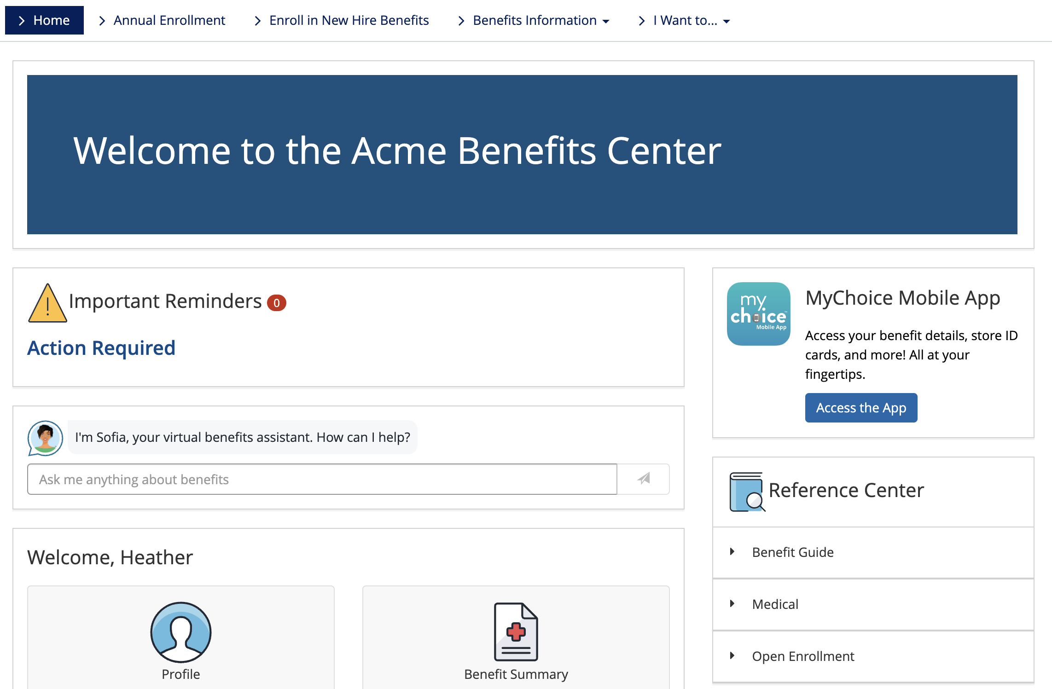
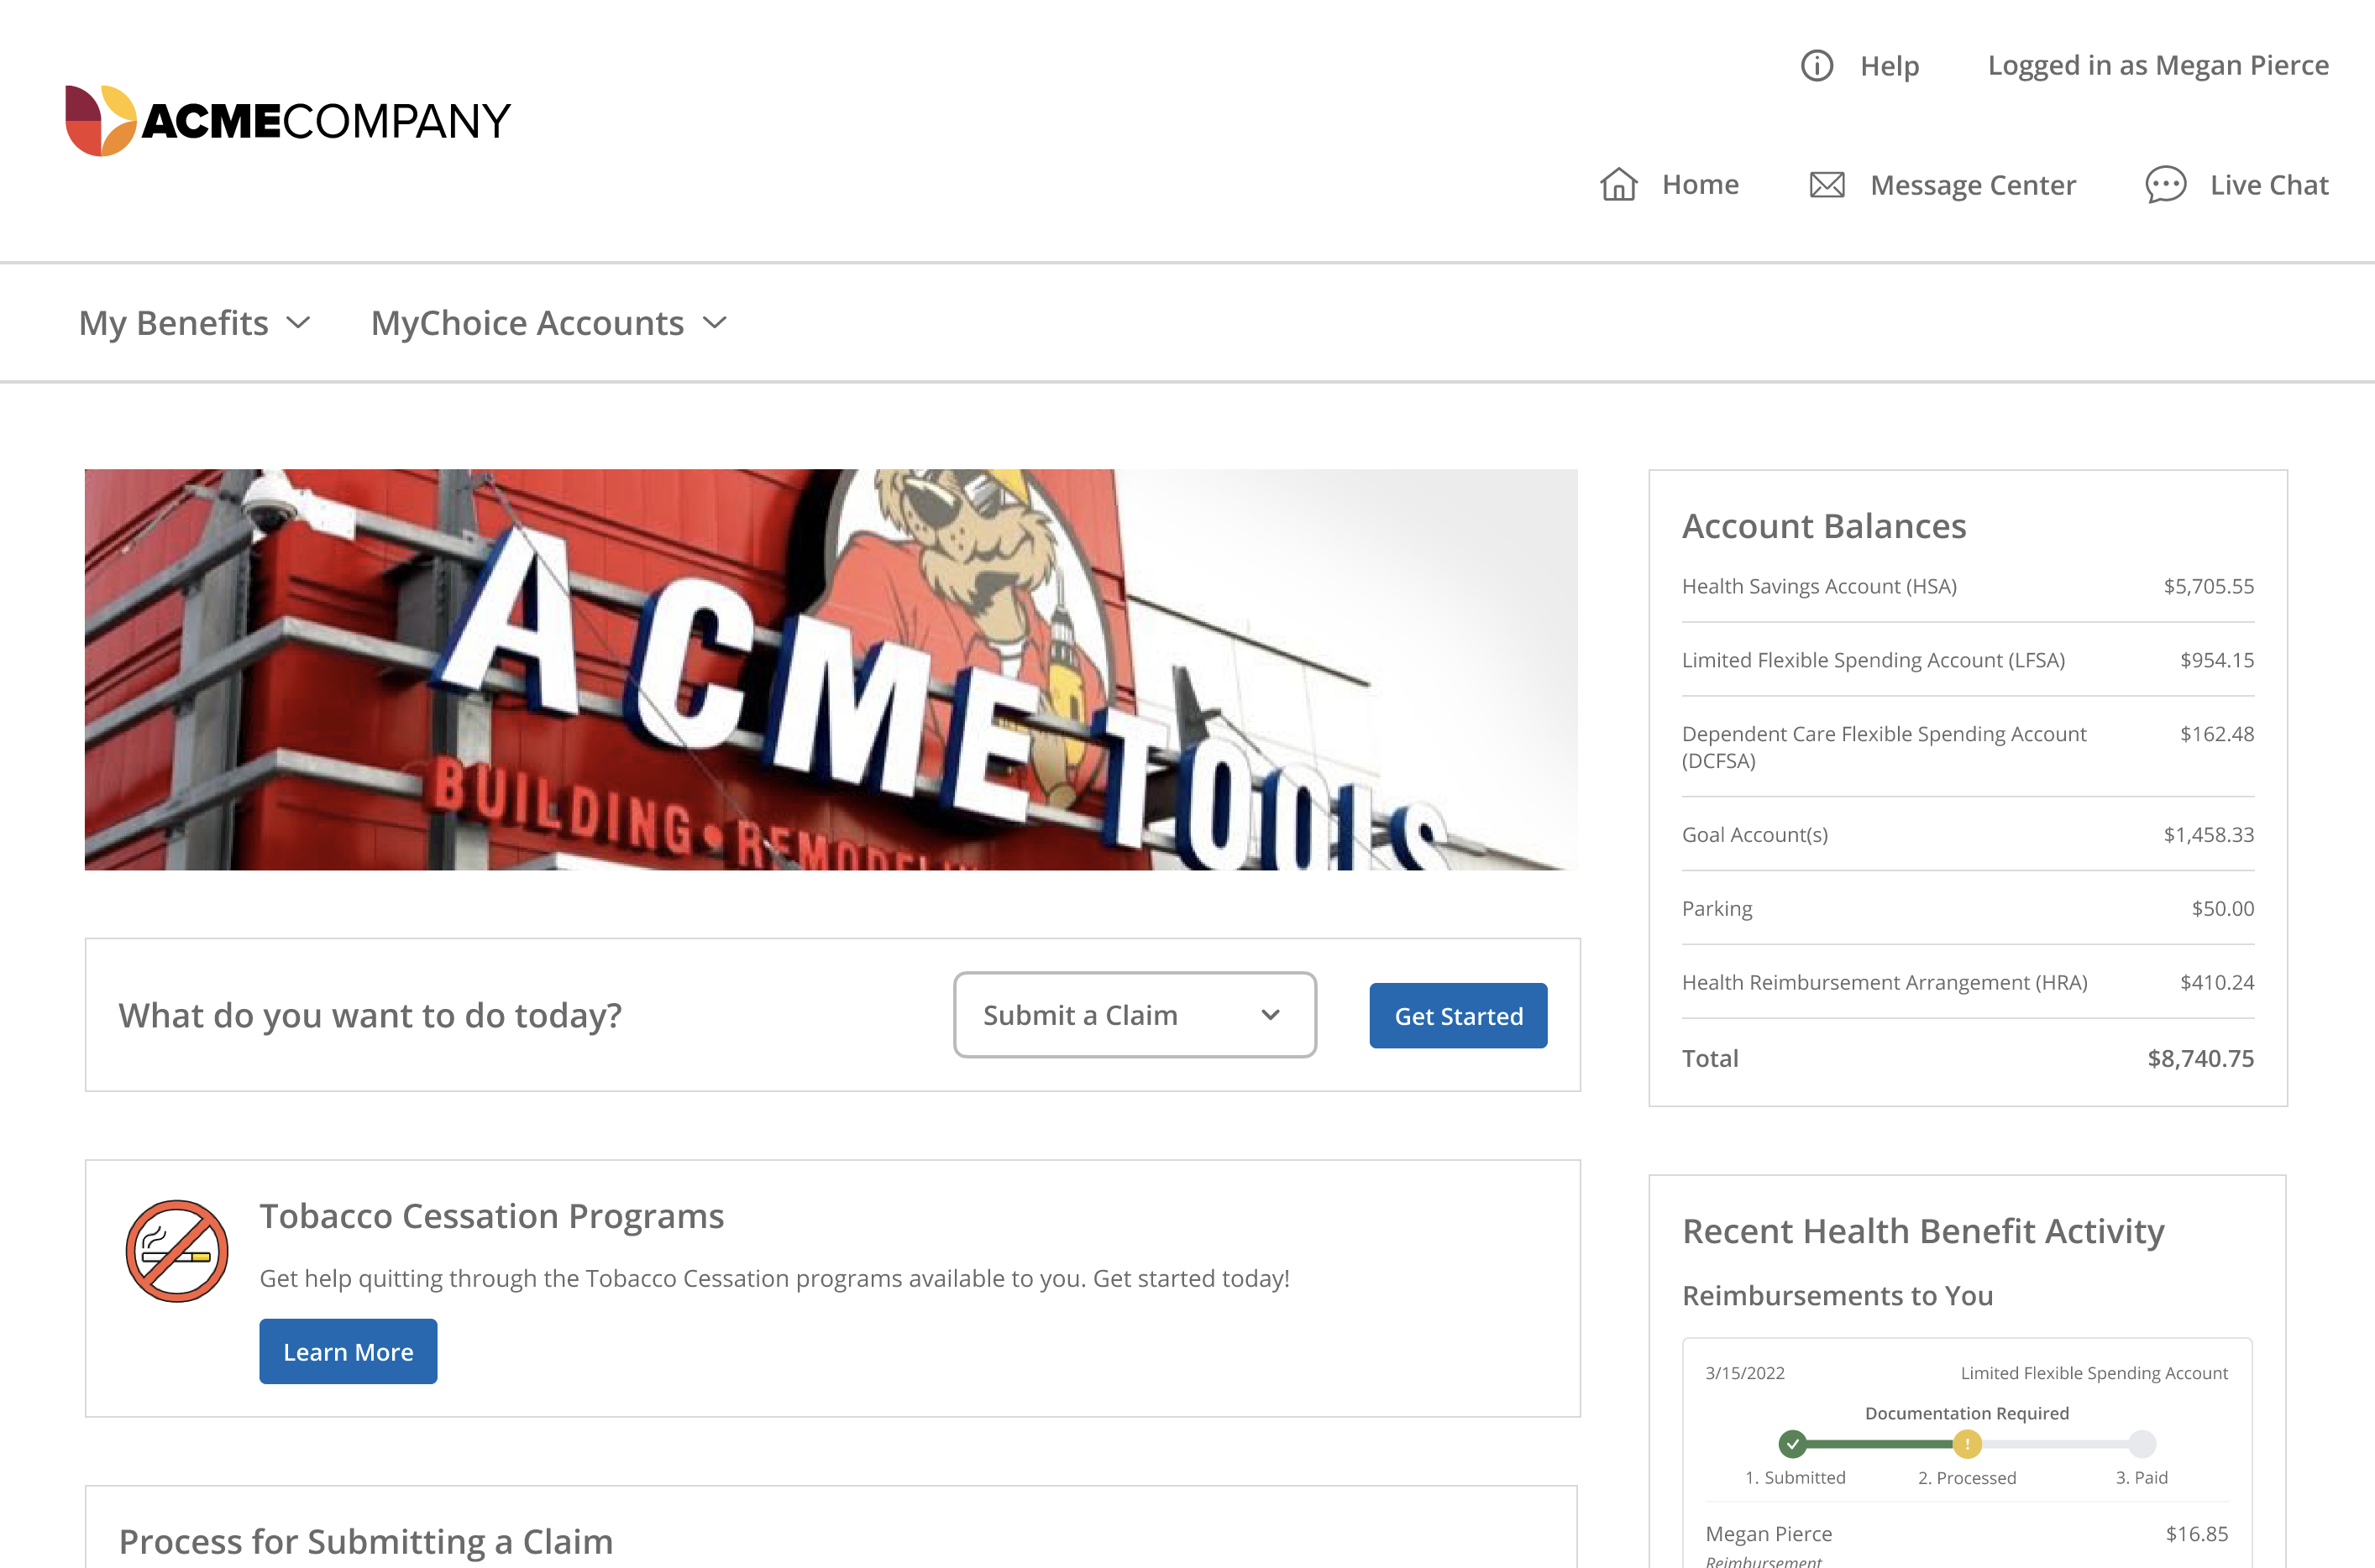
Where Can I Learn More?
Online portal or MyChoice®️ benefits app
Sofia
Videos
FAQ
Deadlines
Calculator links
Member services
www.[CLIENT NAME]WEBSITE
Notes:
Enrolled employees have access to an online portal, an online one-stop-shop for account information and health education tools. In here, you can view account balance and transactions, submit and view claims, reimbursement requests, manage personal and direct deposit bank information and manage your spending debit card.
This website where you can go to enroll and get more information will be the same one that you go to for viewing your account. If you are a new enrollee, your account information will be available on January 1.

Slide 48
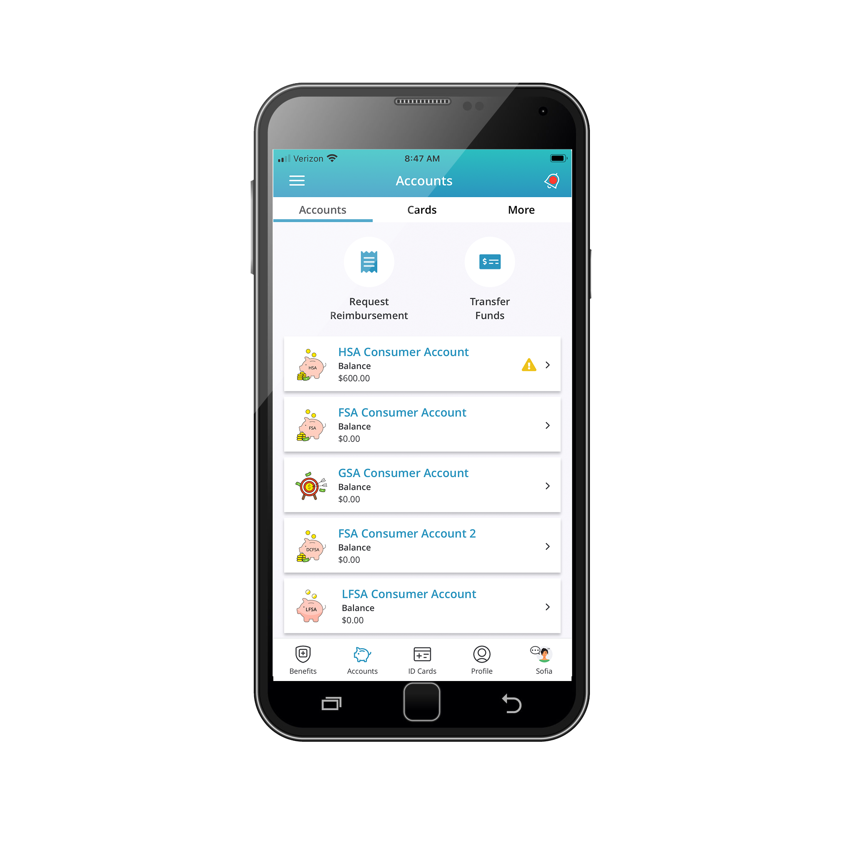
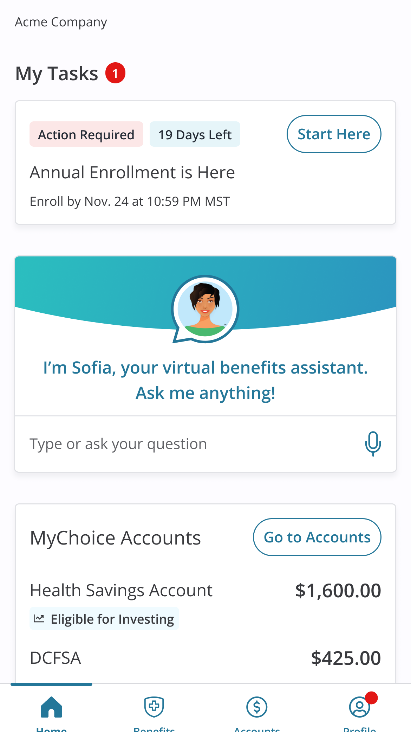
Is there an App for that?
MyChoice benefits app
Available for Android and iOS devices
Account balance, alerts and transaction history
New reimbursement requests
Tap to call Customer Service
Upload claim documentation with your device’s camera
Pay a provider
Add a bank account for direct deposit
Report a lost/stolen card, order extra card
HSA Investments
Notes:
The MyChoice benefits app gives you a quick and easy way to access your account on the go. Just download from your app store and you’ll have a secure and simple way to check your account and make payment requests.
The best part about the mobile app- you can take a picture of your receipts and upload them directly to your account. This make documentation requests fast and hassle-free.
It’s the same user name and password as you use for your enrollment website online.

Slide 49
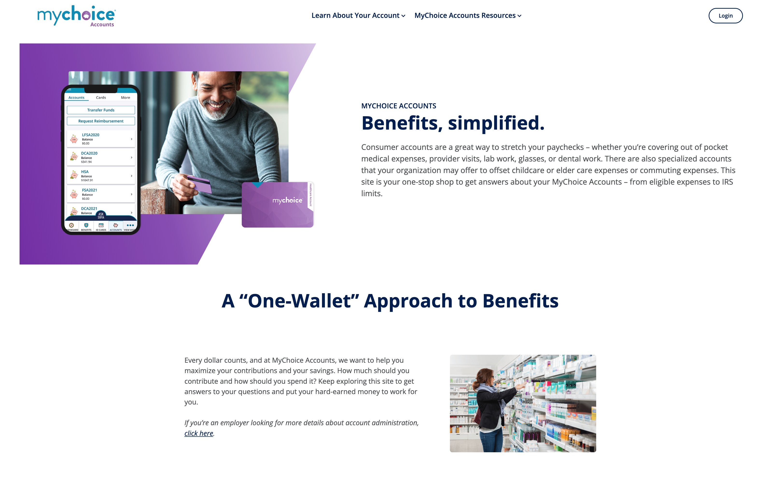
MyChoiceAccounts.com
Resources for Members
General Info on all accounts
FAQs
Savings calculators – to help you select your contribution amount
Videos
Eligible Expense lists/lookup
Coupons for FSA Store and HSA Store
Forms for manual claims submissions or other account activities
Notes:
If you’d like a refresher on anything we covered today, check out our public website at MyChoice Accounts dot com. Here you can watch short explainer videos and see FAQs about the various account types. There are also comprehensive, searchable lists where you can see which items are eligible. Look through the participants and resources tabs for more information.

Slide 50
Using Your Accounts
Notes:
Click to play the video.
Video link if playing through the powerpoint doesn’t work as expected:
https://vimeo.com/461994152/c0c07669a0

Slide 51
Questions?
Notes:
{use for all account types}

