Slide 1
MetLife + Businessolver Pinnacle Program Overview

Slide 2


Today’s Discussion
Who is Businessolver?
Alignment: MetLife and Businessolver
What is the Pinnacle Program
How MetLife and Businessolver Work Together

Slide 3
Who is Businessolver?

Slide 4

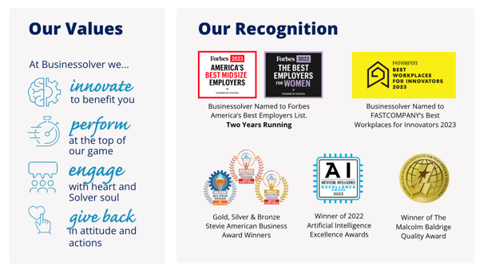
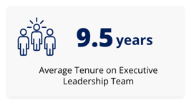
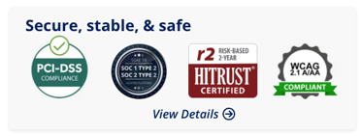
Businessolver at a Glance

Slide 5
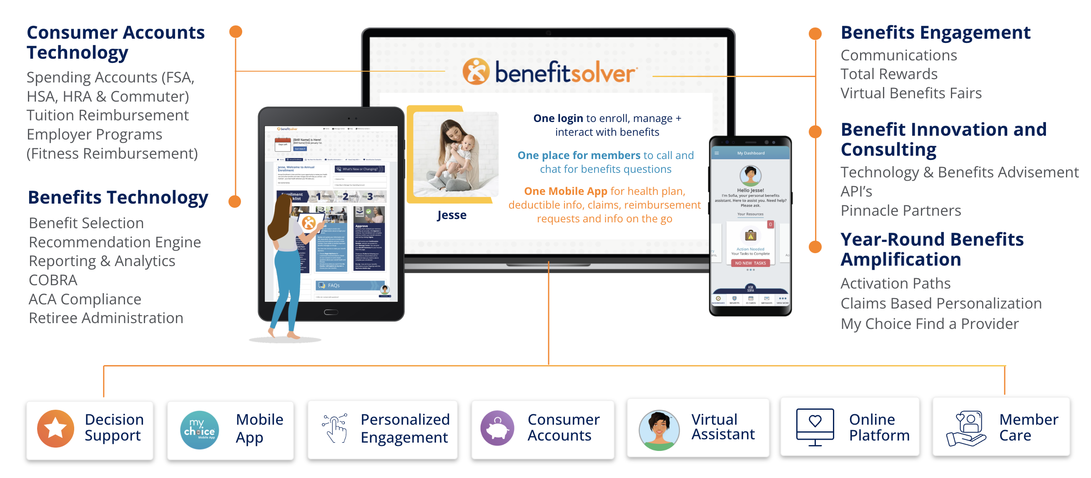
A Comprehensive Benefits Solution

Slide 6
Alignment: MetLife and Businessolver

Slide 7
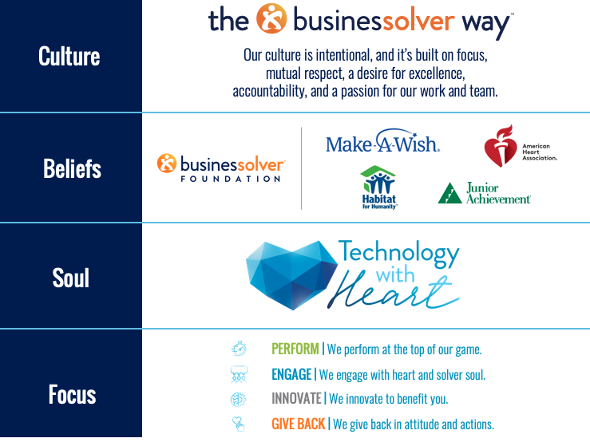


Organizational Alignment
MetLife offers solutions and guidance to help customers meet their goals and navigate life's twists and turns.
At MetLife Foundation, we believe financial health belongs to everyone. We bring together bold solutions, deep financial expertise and meaningful grants to build financial health for people and communities that are underserved and aspire for more.
For 150 years, MetLife has operated as a
good corporate citizen. MetLife has helped generations of people around the world protect their finances, property, family and future.
HEALTH
FAMILY
FUTURE
WORK

Slide 8
What is the Pinnacle Partner Program?

Slide 9

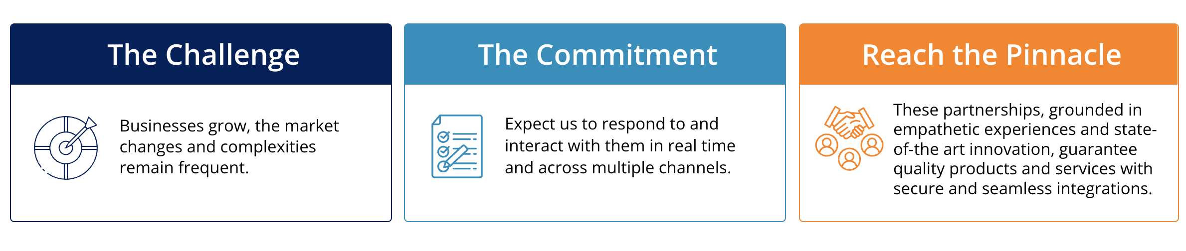
Pinnacle Program

Slide 10

Pinnacle Partner Commitments
Dedicated Carrier/Provider Teams
Support for your benefits -- onboarding and beyond
Strategic alignment
Standardization of Processes
Ease of implementation and ongoing support
Less rework and escalations
National Agreement
Improved integration costs
Reinvestment to support the carrier and integrations
Relationship Across Organizations
Ability to work directly with the carrier/provider
Demonstrates true partnership
Enhanced Integrations
Higher priority for integration enhancements
Focus on better member experience
Business Growth
Leverage combined market expertise to drive opportunities
Collaborate to provide client delight

Slide 11
How MetLife and Businessolver Work Together

Slide 12
The Pinnacle Partners
MetLife is a “Preferred” Voluntary Benefits Carrier
As a carrier with the highest Pinnacle level relationship with Businessolver, MetLife represents the voluntary benefits carriers that provide the BEST integrated client and member experience!
Together, the partnership between Businessolver and MetLife includes flexible designs, administration and value-added services. This helps ensure clients have a seamless customer experience.
    Flexible: Leverage technology to offer seamless integration of flexible, innovative products and services within the Benefitsolver platform.
    Service: Maximize favorable benefits and enrollment experiences for employers and employees, with a dedicated service team to ensure all goes smoothly, end-to-end.
    Innovation: Continued innovation to deliver to a comprehensive solution and voluntary products based in data-driven outcomes.
    Commitment and collaboration: Drive employee education and engagement through MyChoice and Sofia, to ensure employees have the benefits that best suit their needs.

Slide 13

Products Supported on Benefitsolver
Hosted On
Dental
Vision
Short Term Disability
Long Term Disability
Basic Life
Basic AD&D
Dependent Basic Life
Optional Life
Optional AD&D
Spouse Optional Life
Spouse Optional AD&D
Child Optional Life
Child Optional AD&D
Legal
Identity and Fraud Protection powered by Aura
Accident Insurance
Hospital Indemnity
Critical Illness (Attained Age)
Dependent Critical Illness Attained Age
Critical Illness Level Funded
Dependent Critical Illness Level Funded
Cancer Insurance
Dependent Cancer Insurance
Worksite Short Term Disability
Available Through Additional Integrations
Auto & Home Insurance
Pet Insurance
Group Universal Life
Group Variable Universal Life
FMLA / NY Paid Leave

Slide 14
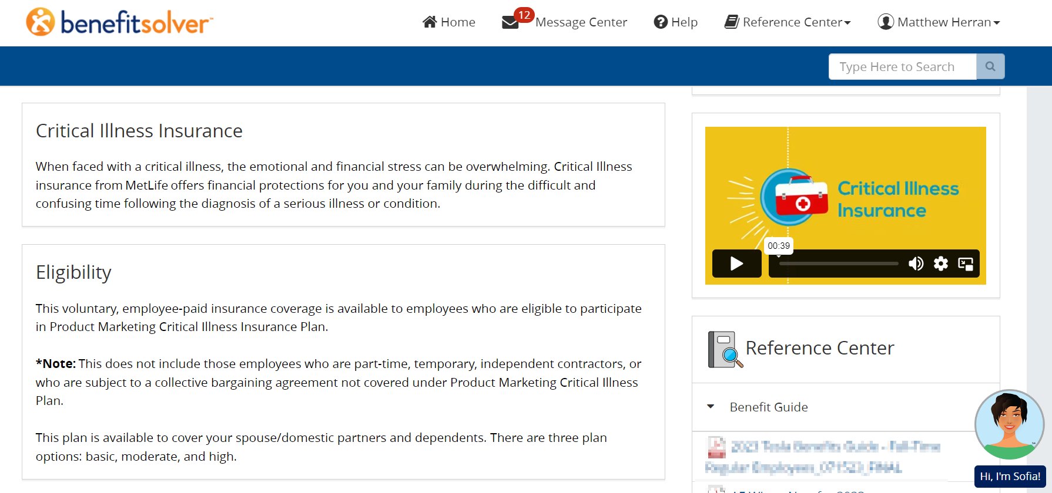
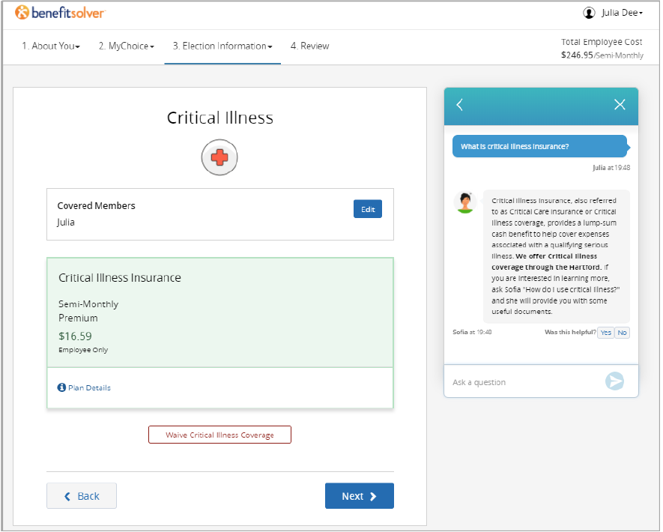
Employee Experience
The Benefitsolver Difference

Slide 15
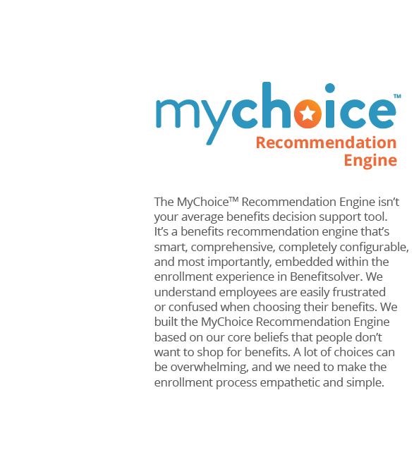
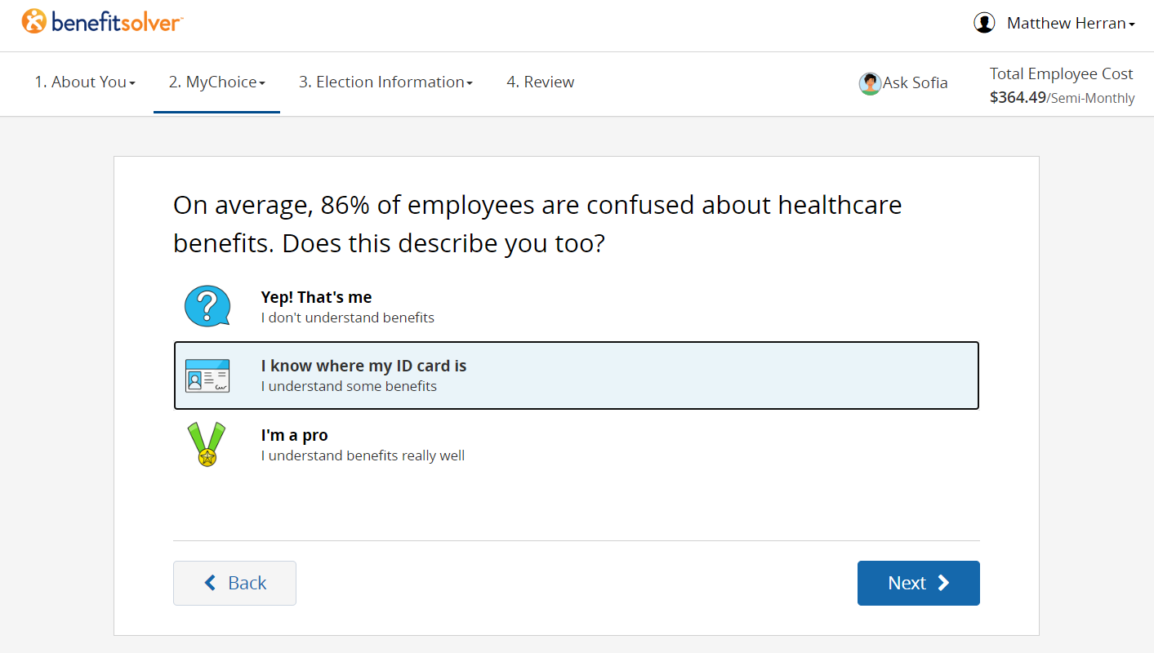
Employee Experience – Decision Support

Slide 16
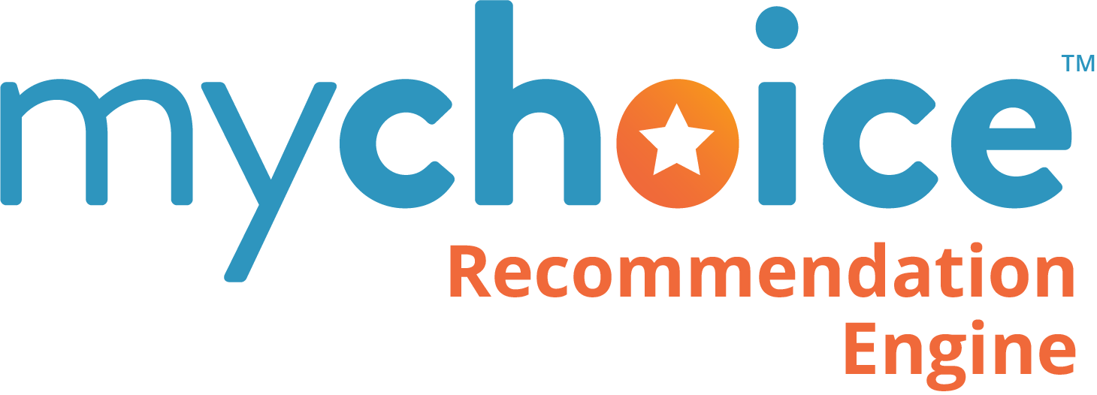
MetLife & Businessolver Relationship
Quick facts and stats
200+ MetLife customers on the Businessolver platform
>$600M of in force premiums
15,500 employee average customer size
Increased participation when utilizing MyChoice
80% of Businessolver clients utilize Member Services
  Utilization is higher for large National Accounts

Slide 17
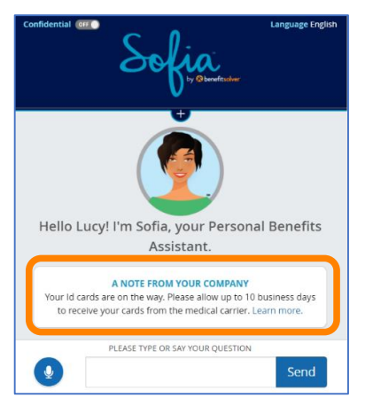
Employee Experience
A machine-learning intelligence application, Sofia is Benefitsolver’s personal benefits assistant. Her ability to navigate employees where they need to go, armed with the information they are seeking, takes pressure off employees in becoming benefits
experts while providing a hyper-personalized experience.
At her core, Sofia is a technology built to create a more meaningful and efficient benefits experience, one that allows employers to better engage their employees in all the benefits programs and
services offered.
Whether an employee is looking for information about their benefits or trying to understand what an upcoming surgery may bring, Sofia is their guide in finding the information they need that will lead to better outcomes for all.

Slide 18
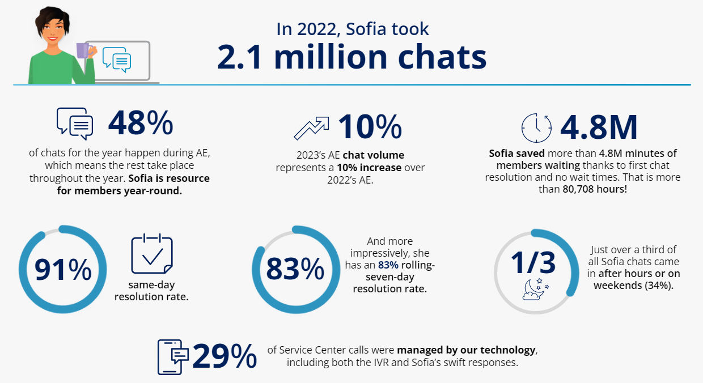
Tools to Support: Sofia™
Delivering AI-enabled Support during 2023 Annual Enrollment
Page Source: Benefitsolver (data collected in 2022)

Slide 19
A suite of API-based integrations to modernize the customer experience
PPO Provider Directory API
Integration making it easier for employees to search and view available providers on the benefitsolver platform
EOI Status Pull API
Pull status changes from MetLife and provide applicants ability to view their status
Enrollment XML File Standards
Data format standardization and quality standards promoting reduction of errors and testing cycles
Enrollment File Standards API
Data format standardization and quality standards promoting reduction of errors and testing cycles via API
Risk Rules API
Easy, repeatable process to integrate MEOI risk rules for Life coverage into enrollment processes via an API
*

