Slide 1
Clients, to customize this file, please copy/paste the account entries that align with your offered accounts and place them in the top box of page 2.
When you’ve finished, delete this slide and save your file.
Then select SAVE AS and select PDF as the file type.
Health Savings Account (HSA): an individual savings account to help individuals cover out-of-pocket medical expenses. Requires enrollment in a high deductible health plan (HDHP). HSAs never “expire,” as funds roll over year over year. Learn more.
Health Care Flexible Spending Account (FSA): allows participants to set aside pretax funds from their paychecks to help them pay for approved out-of-pocket health care expenses. FSAs are an annual plan-year benefit—meaning funds will either expire or a portion of the funds roll over to the following year—depending on your employer’s plan. Spend down this account every year based on your plan’s rules. Learn more.
Dependent Care FSA (DCFSA): pair with almost any other kind of consumer account. It is an account to help participants pay for out-of-pocket child care or other dependent care (disabled spouse/child or elder care) expenses. Learn more.
Health Reimbursement Account (HRA): an employer-sponsored and employer funded account designed to help cover certain out-of-pocket medical expenses that are not covered by your health plan. Learn more.
Commuter Benefits: these pre-tax benefits allow participants to set aside funds to help them cover transit and/or parking expenses related to their work commute. Learn more.
Tuition Reimbursement: you have access to funds to help you cover your education-related expenses. Learn more.
Adoption Benefits: we offer reimbursements for adoption-related expenses, such as legal fees, adoption-related travel, and more. Learn more.

Slide 2
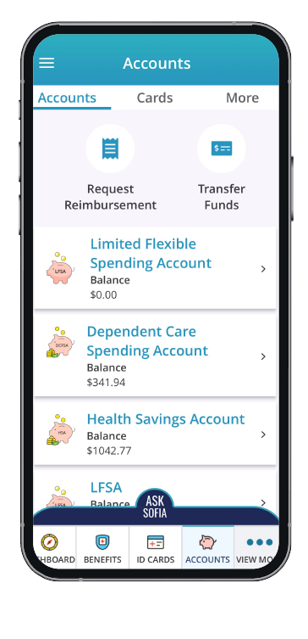
Welcome to MyChoice® Accounts
Health Savings Account (HSA): an individual savings account to help individuals cover out-of-pocket medical expenses. Requires enrollment in a high deductible health plan (HDHP). HSAs never “expire,” as funds roll over year over year. Learn more.
Health Care Flexible Spending Account (FSA): allows participants to set aside pretax funds from their paychecks to help them pay for approved out-of-pocket health care expenses. FSAs are an annual plan-year benefit—meaning funds will either expire or a portion of the funds roll over to the following year—depending on your employer’s plan. Spend down this account every year based on your plan’s rules. Learn more.
Dependent Care FSA (DCFSA): pair with almost any other kind of consumer account. It is an account to help participants pay for out-of-pocket child care or other dependent care (disabled spouse/child or elder care) expenses. Learn more.
Health Reimbursement Account (HRA): an employer-sponsored and employer funded account designed to help cover certain out-of-pocket medical expenses that are not covered by your health plan. Learn more.
Your MyChoice Account Resources
It’s easy to manage all your benefit spending accounts with these resources:
Your MyChoice Accounts Visa® debit card. Use it to pay for reimbursable, qualified expenses. The card is linked to the accounts you’re participating in, allowing you to manage all your benefit accounts with a single card. Activate your MyChoice debit card according to the instructions in your card mailer when it arrives.
Your Benefits Website. Manage your accounts when you visit your benefits portal, the same website you use for your other benefits. Log in with the same username and password you use for your other benefits. Once logged in, select your name in the right-hand corner and choose MyChoice Accounts from the drop-down menu or select the MyChoice Accounts piggy bank icon.
Your MyChoice™ Mobile App. View your MyChoice Accounts on your mobile device. With the MyChoice Mobile App, you can easily manage your accounts whenever you need, and wherever you are. Simply visit your favorite app store and search for MyChoice Mobile App. You may register the app with your benefits portal username and password or with an access code retrieved from your benefits portal. Download for iOS or Android.

