Slide 1

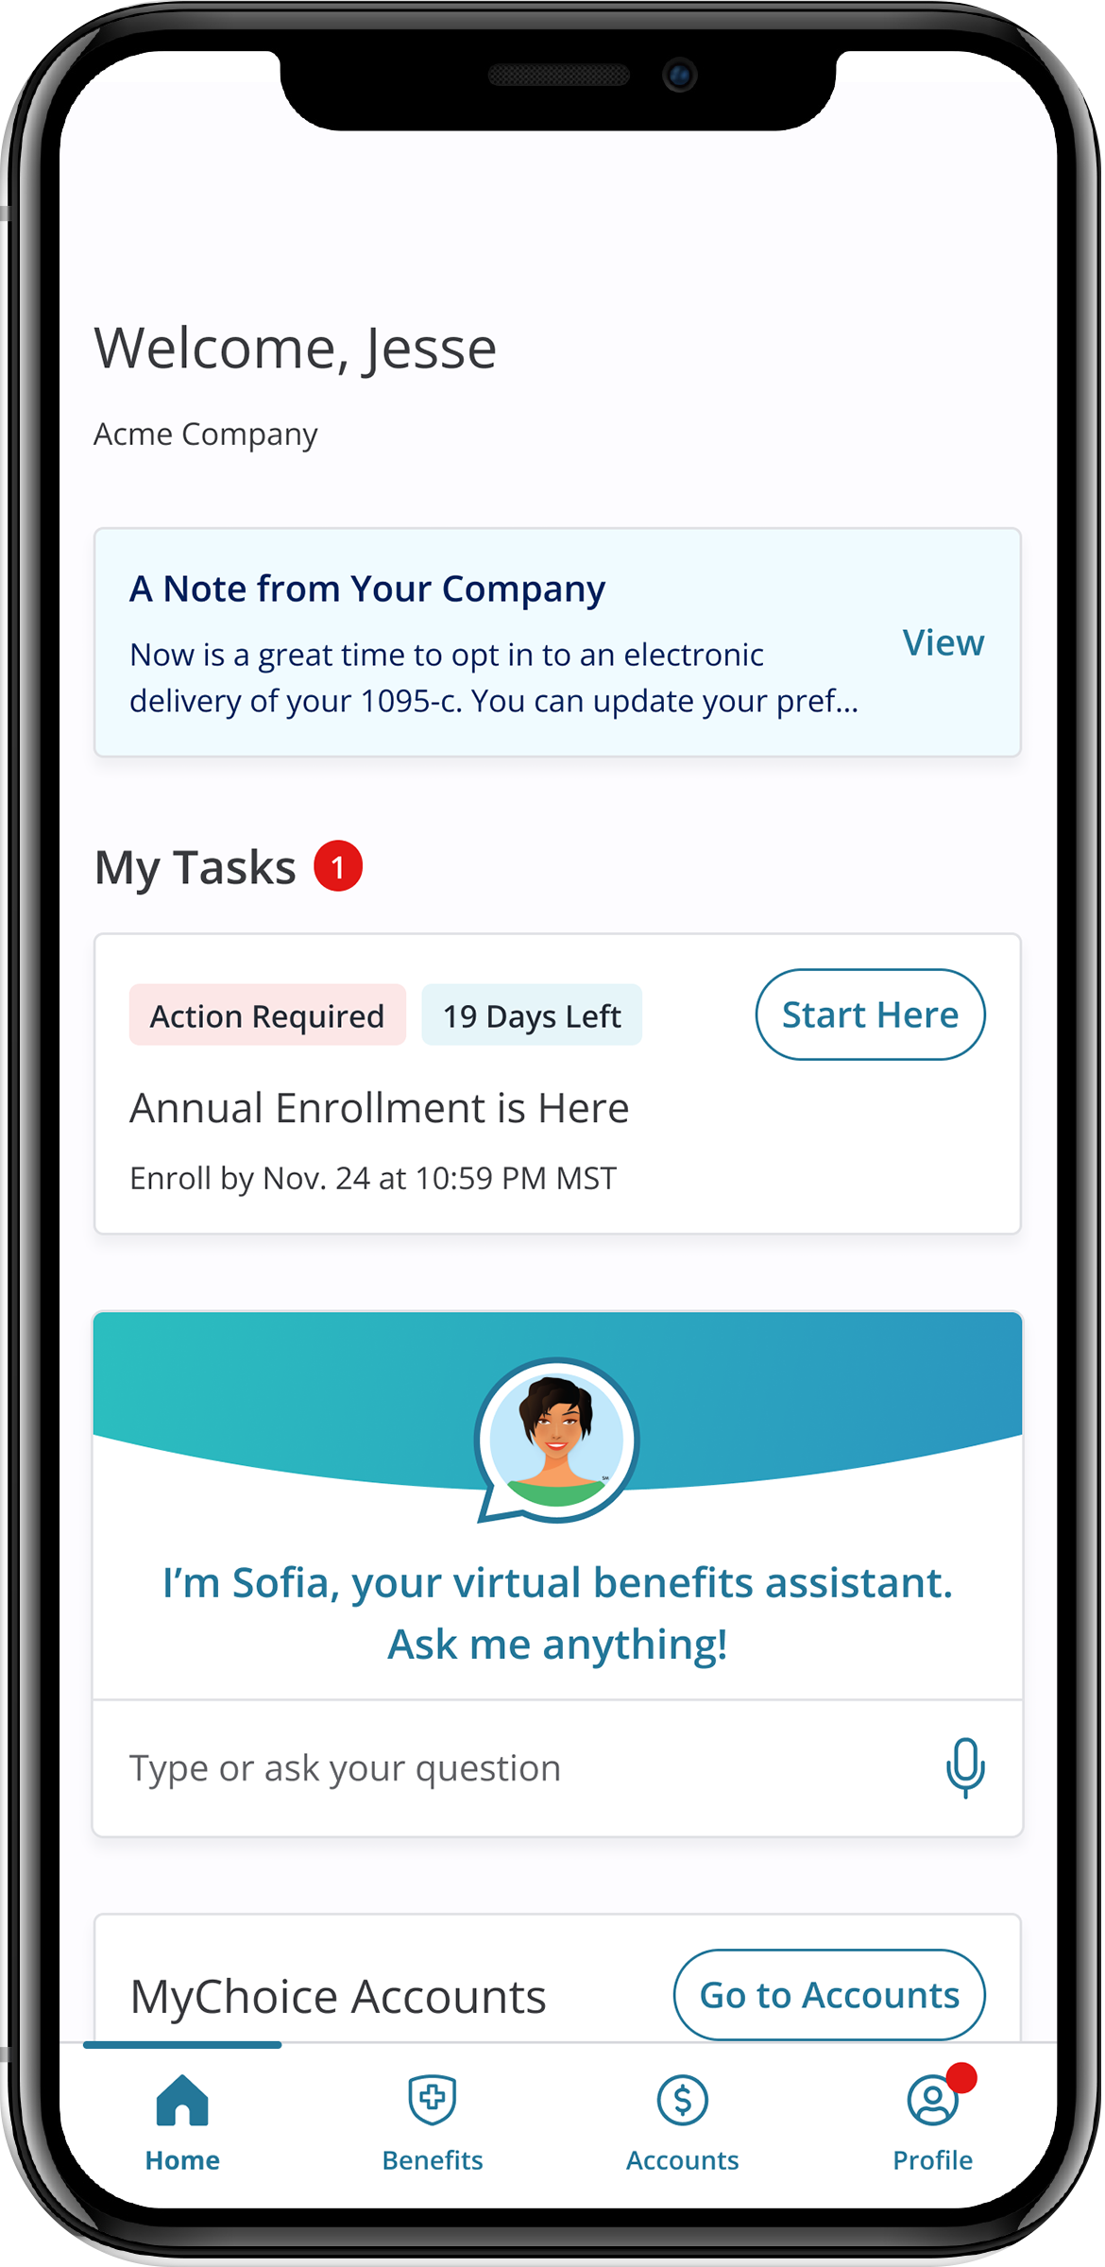
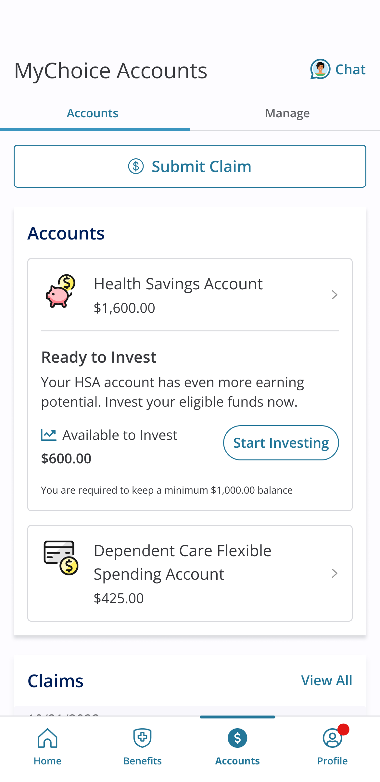
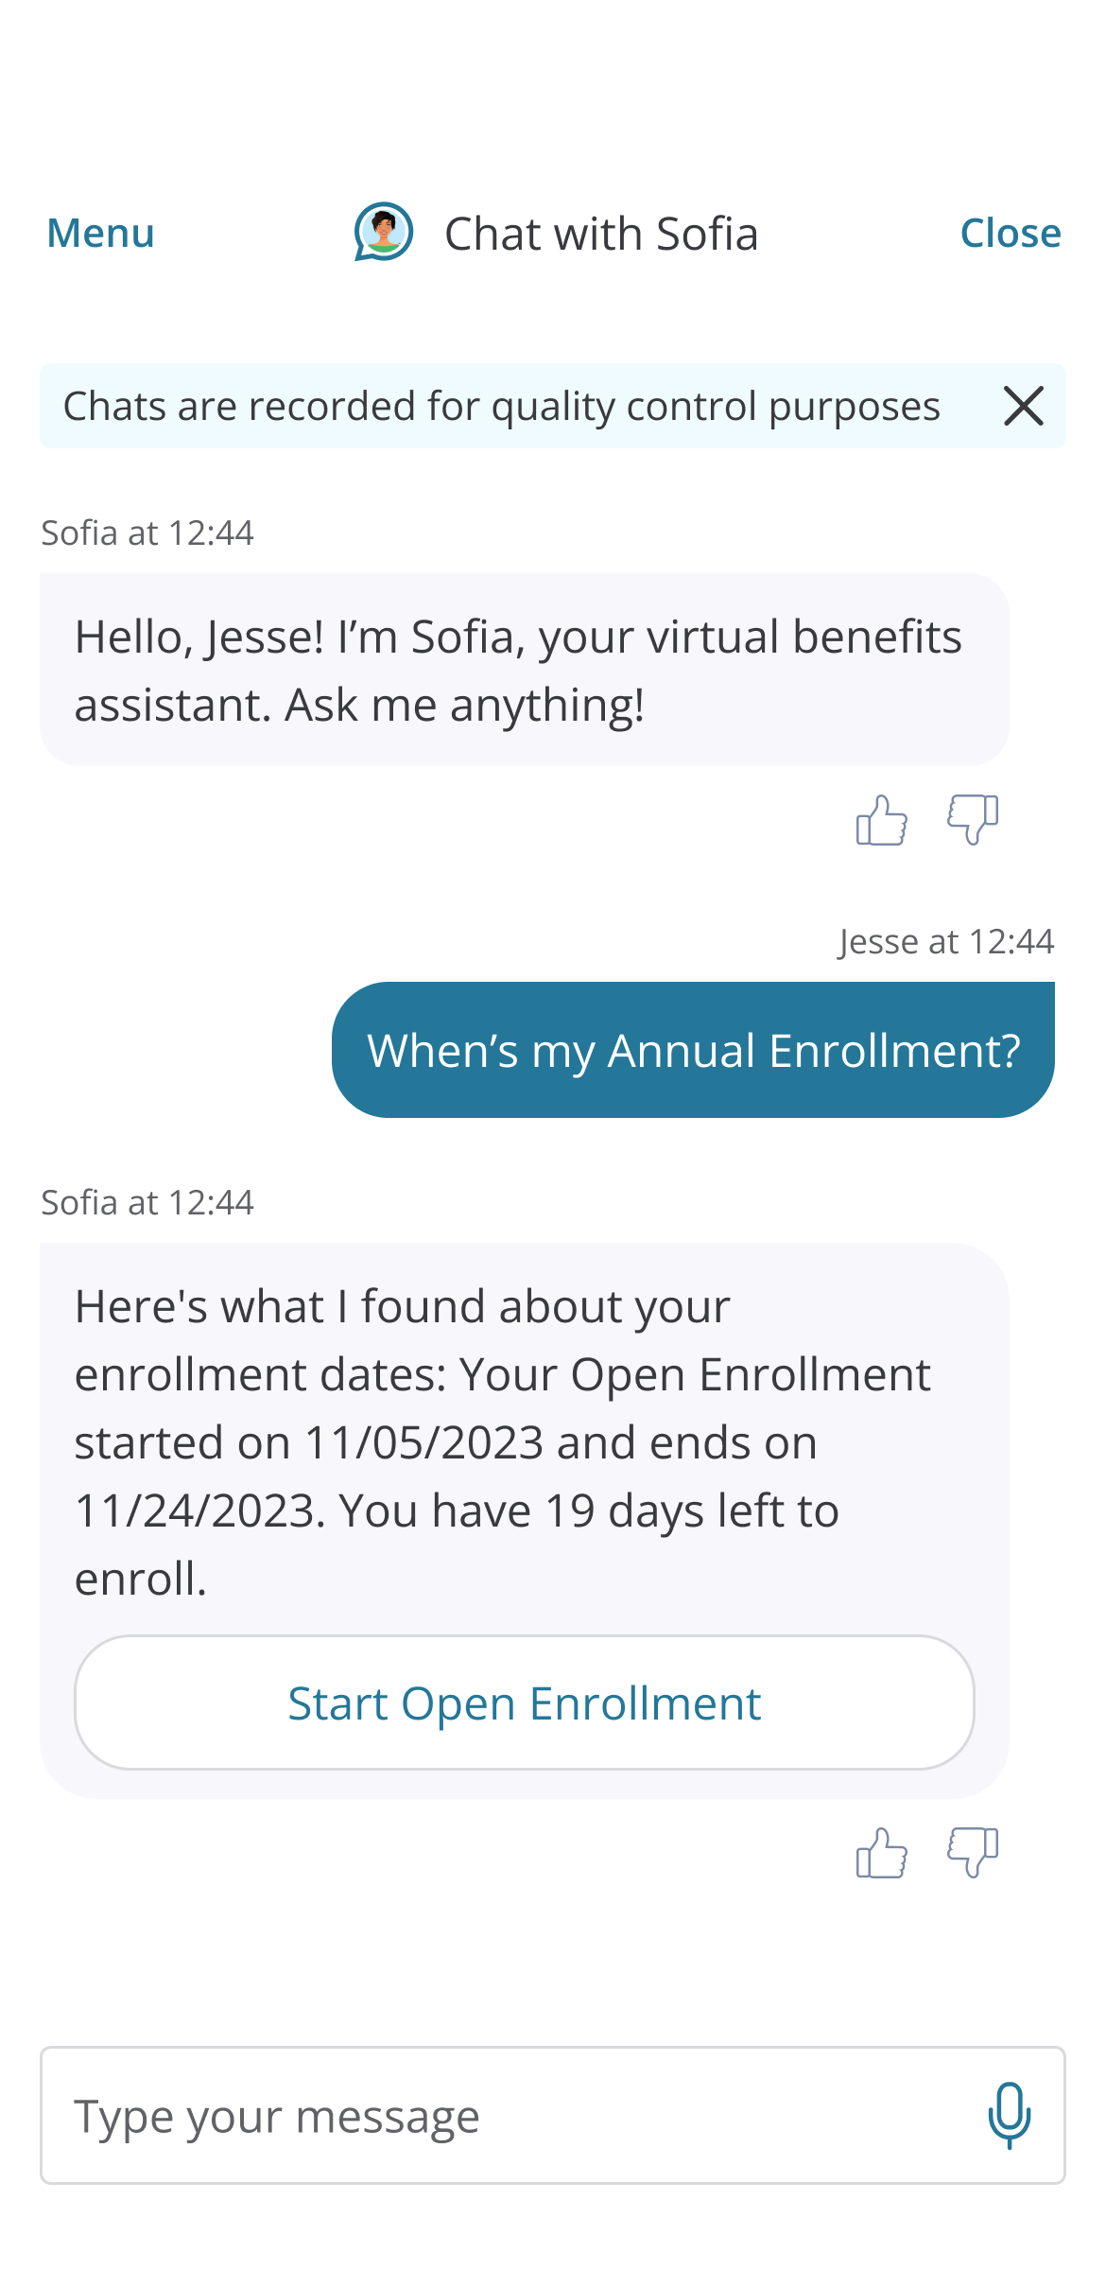
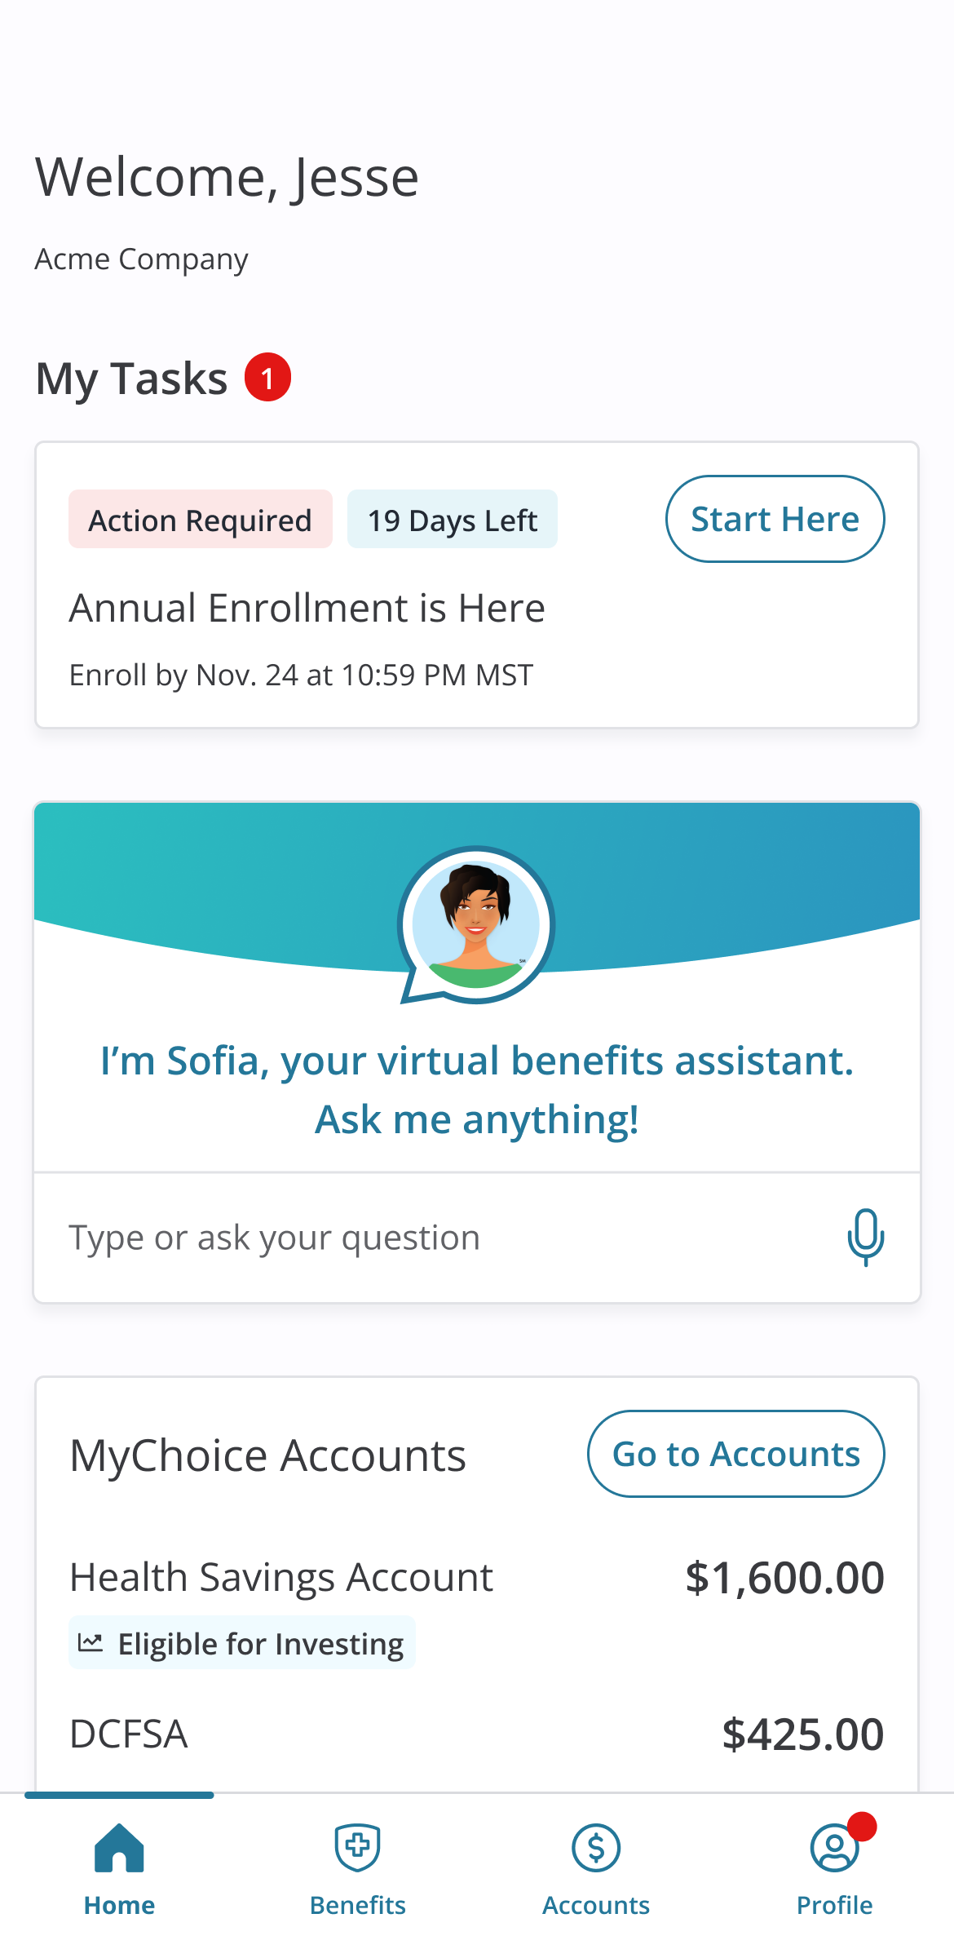

Your Logo Here
Access your benefits information, when and where you need it
Download the MyChoice® benefits app
Never again be stuck at the doctor’s office without your ID card.
Upload important documents in a snap!
24/7 chat with your personal benefits assistant, SofiaSM

Slide 2







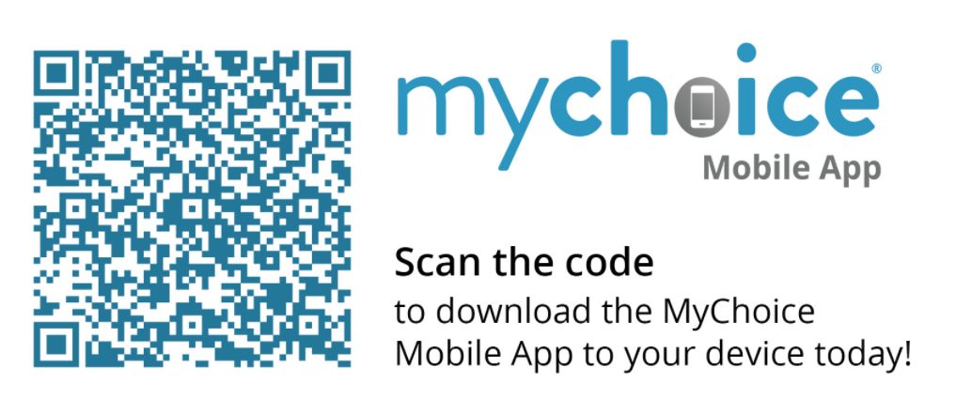
Access your benefits information on the MyChoice® benefits app!
Manage your MyChoice® Accounts
View your benefits information
View or change your beneficiaries
Stay on top of important deadlines
Instant ID card access
24/7 chat with SofiaSM
Your Logo Here
1025 Ashworth Road
West Des Moines, IA 50265
John Doe
123 Any Street
Apt 1234
City, ST 12345
Scan the code to download the MyChoice benefits app to your device today!

