Slide 1

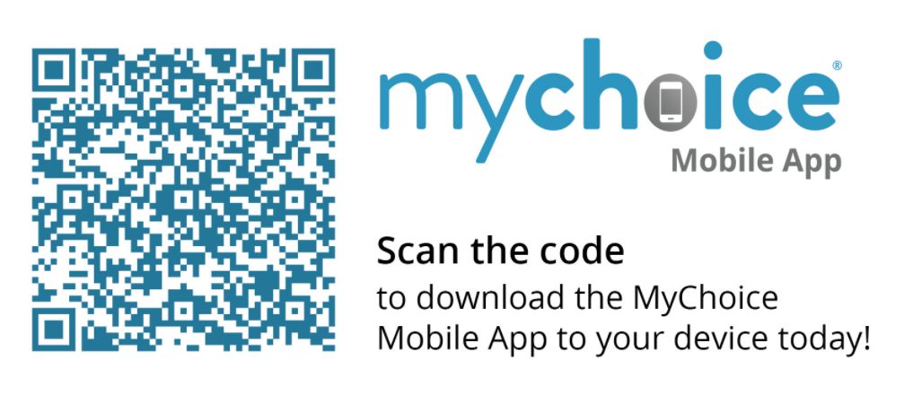
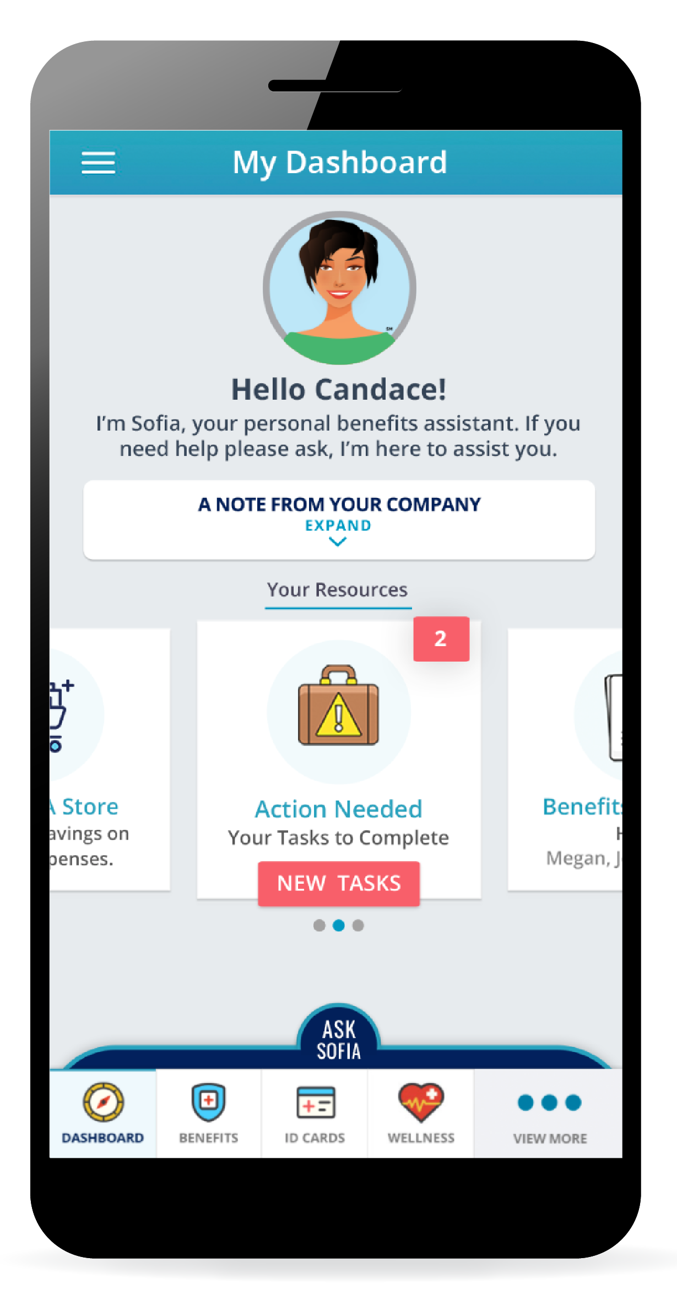
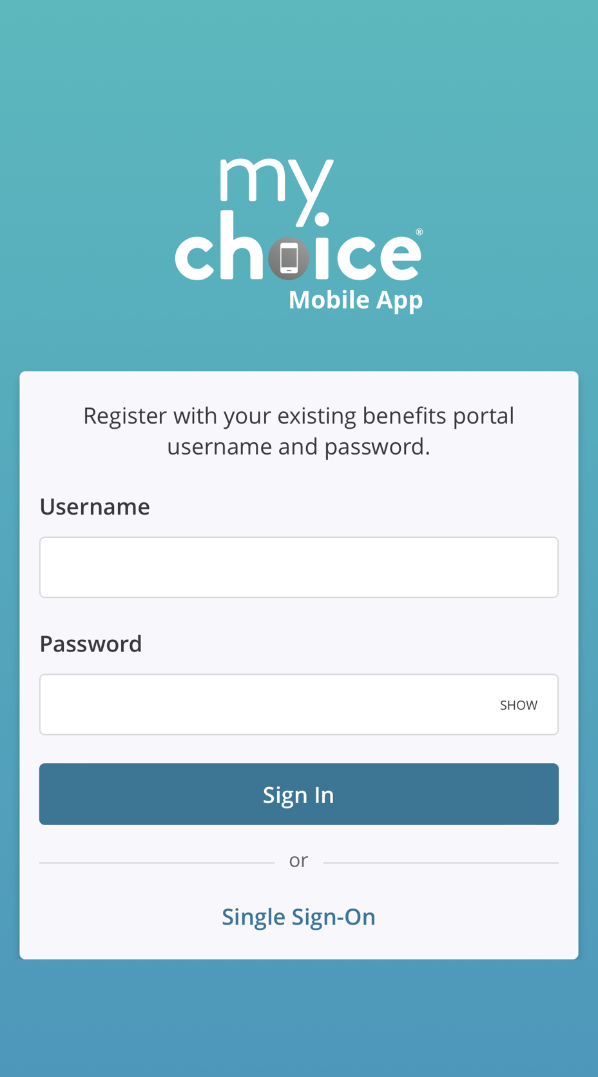
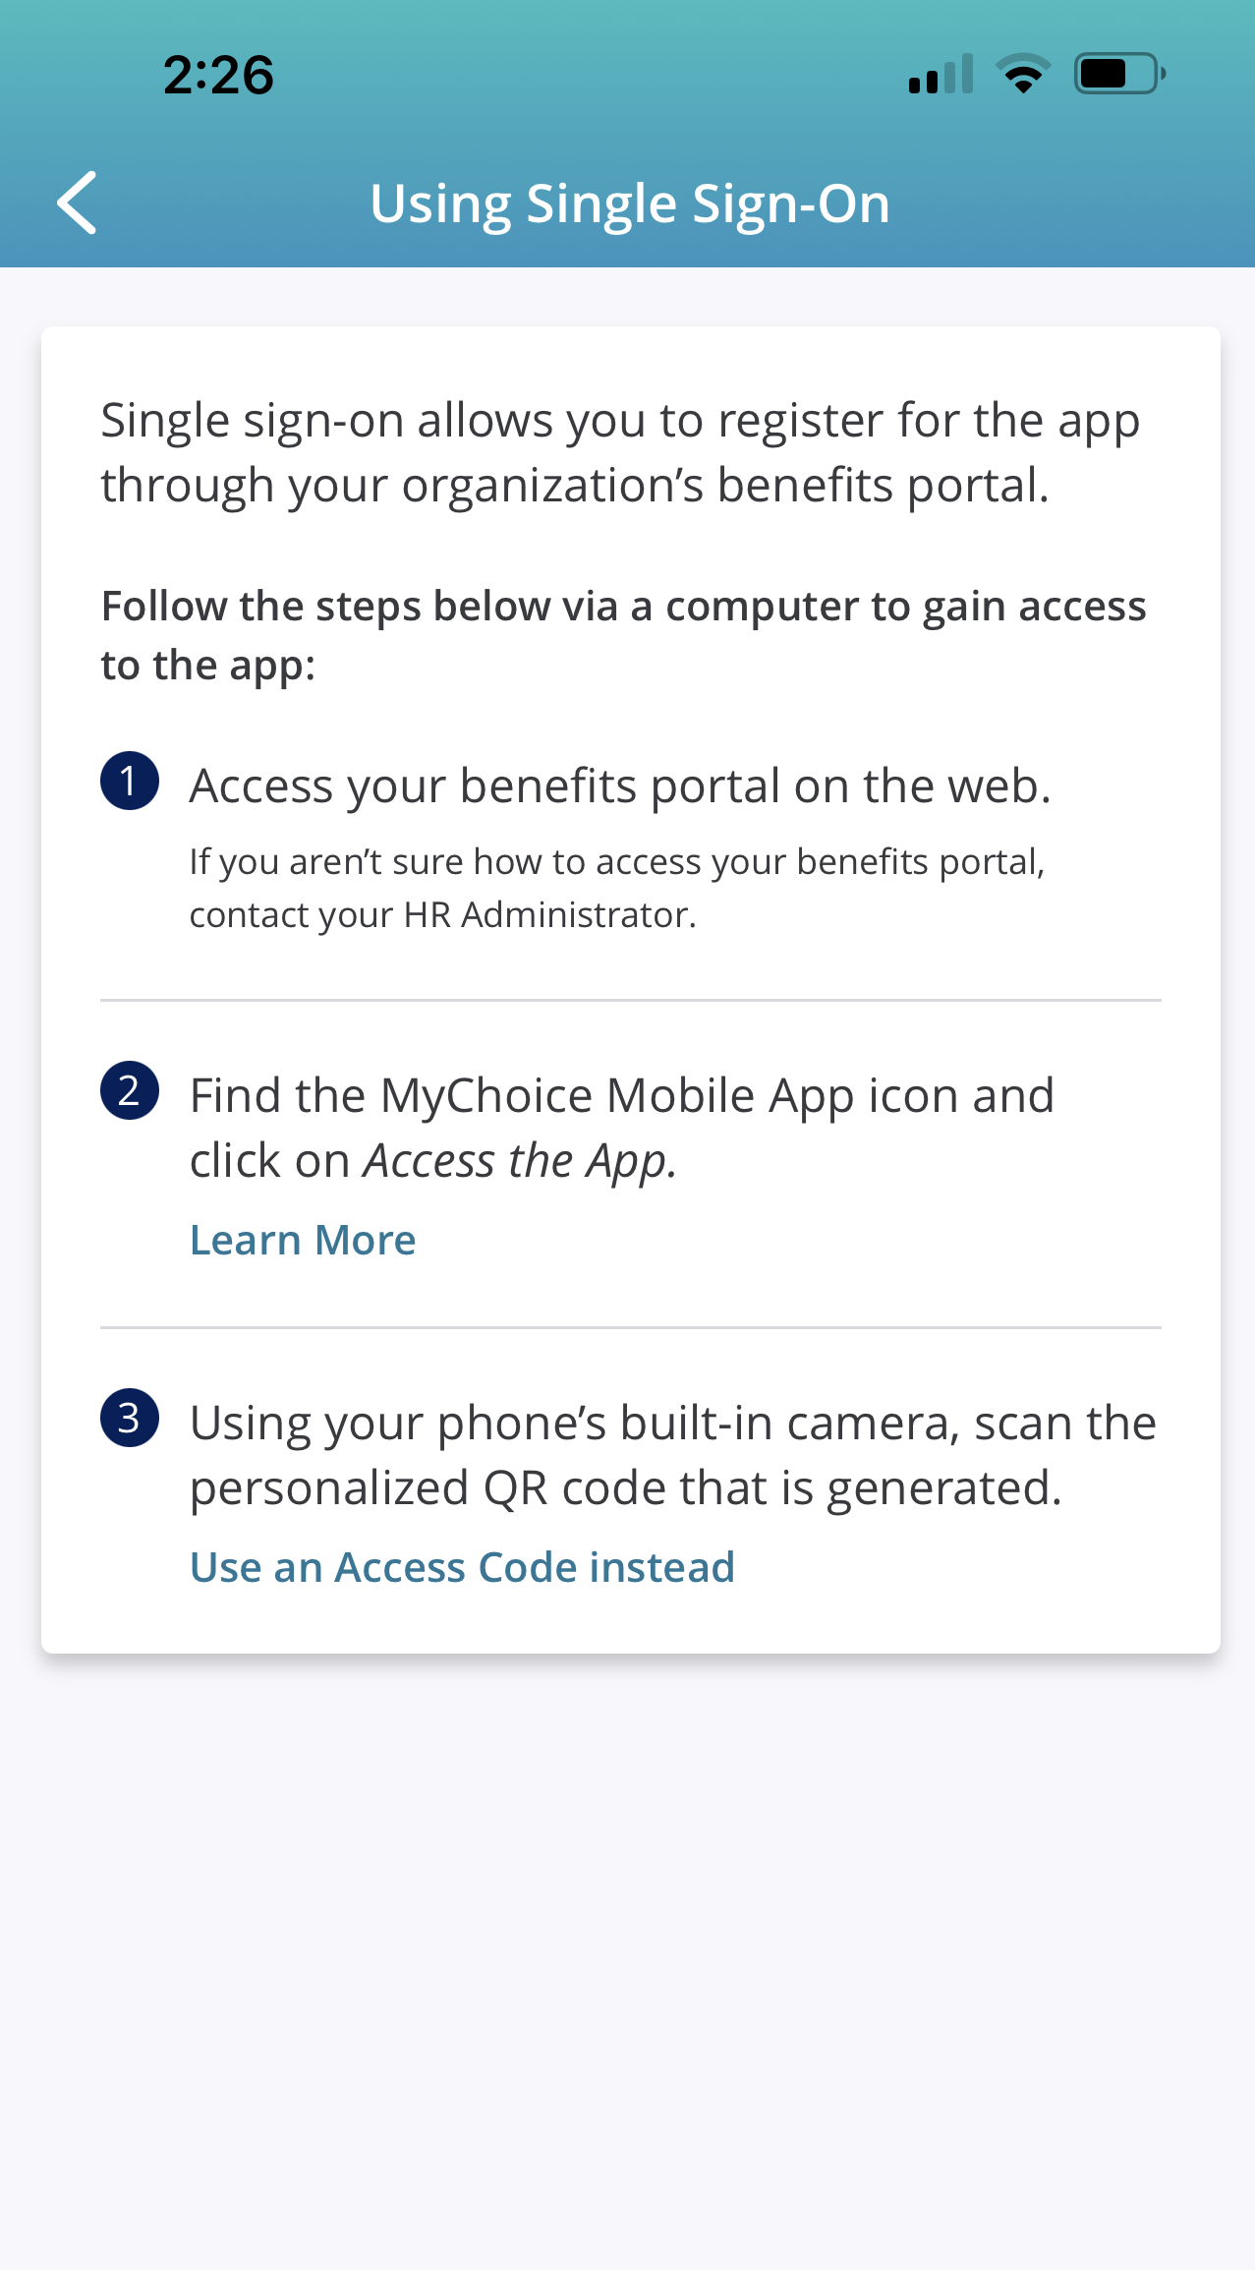
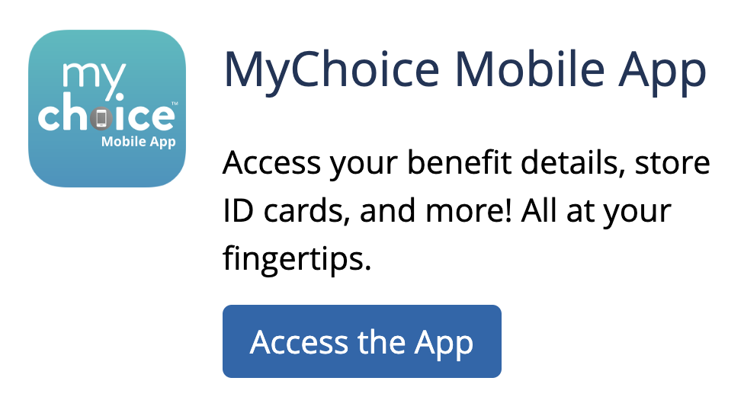
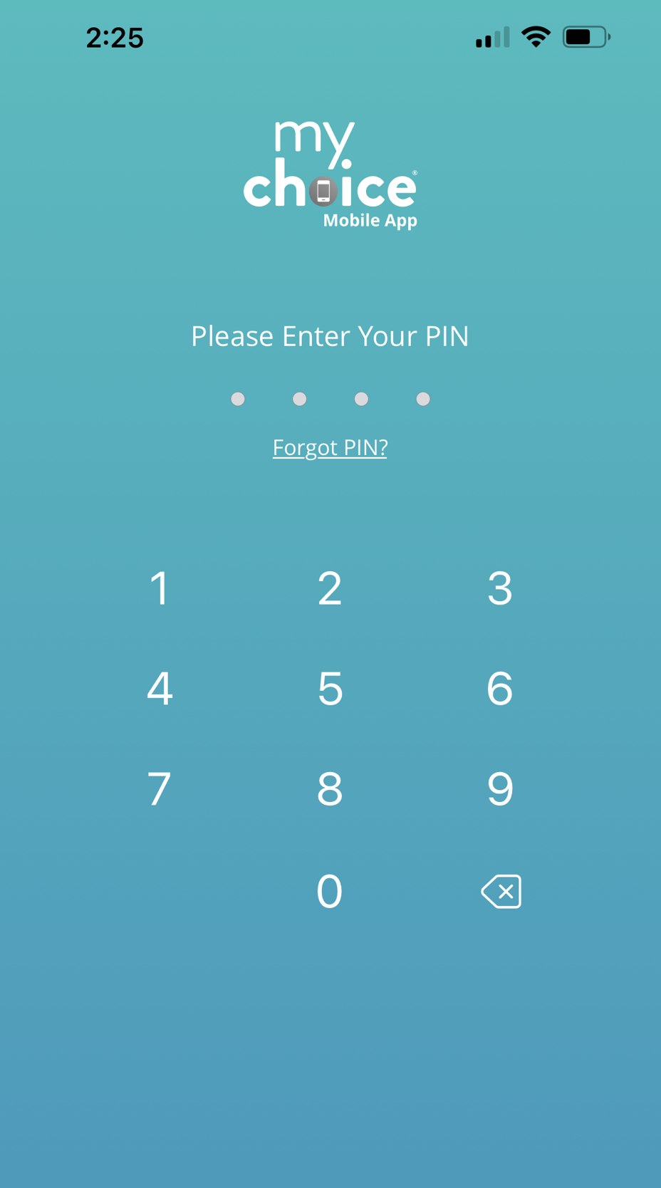
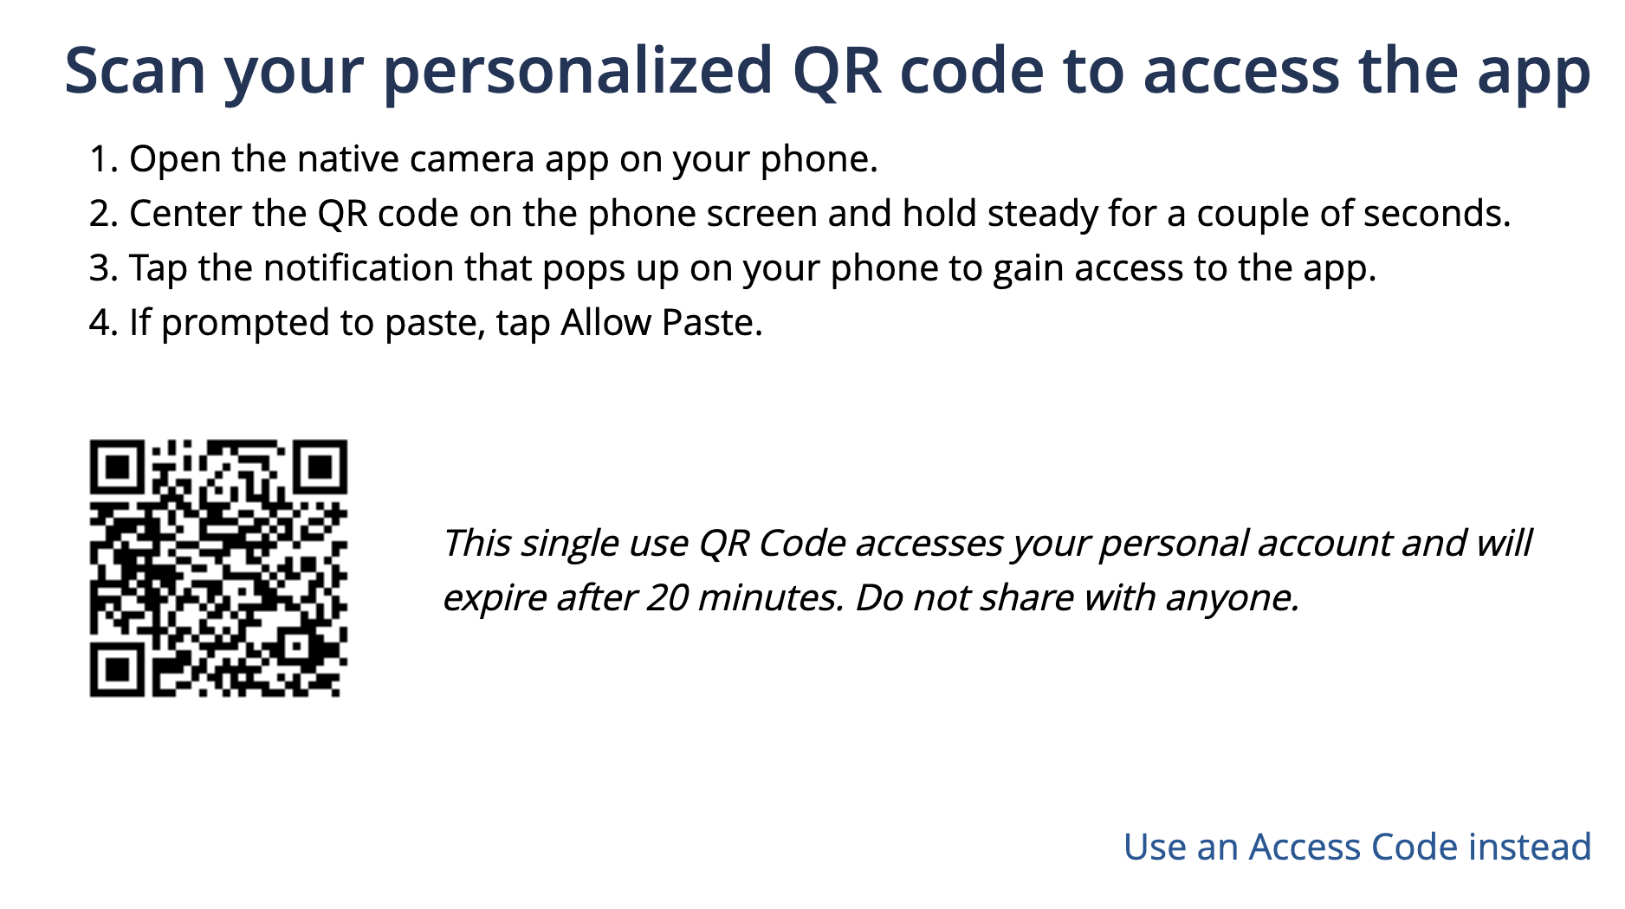
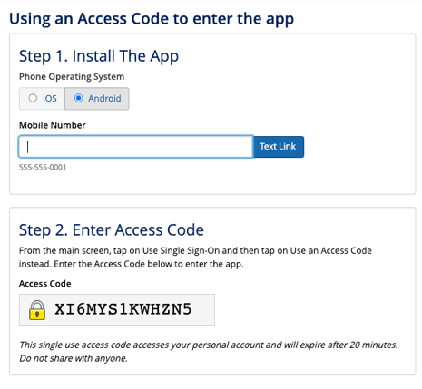
Enroll in Your Benefits on the Mobile App
Your Logo Here
Enroll Oct. 15th – Nov. 1st, 2024
GET THE APP
Scan the QR Code:
Open your mobile device
and point your camera at
the QR code to the right.
Touch the pop-up website on your screen.
Instantly Download the free app from your device’s store.
Log in using your Benefitsolver username and password, and click Sign In.
To access the app via Single Sign-On, log in to your benefits portal.
Download from Benefitsolver:
Log in to www.benefitsolver.com using your username and password.
Click the Access the App button. A pop-up window will give you the following options to get the app:
Scan your personalized QR code with your phone’s camera to open your device’s app store and download the app.
Use an Access Code Instead: Select your phone’s operating system (iOS/Apple or Android), enter your mobile number, and click the blue Text Link button. You will receive a text message on your device to download the app. Enter your time-sensitive Access Code in Benefitsolver.
Answer a few security questions and set your 4-digit PIN.
Log in using your PIN.
Forgot your PIN?
Click the link, answer your security question(s), and provide the multi-factor authentication code to reset your mobile app account.

Slide 2
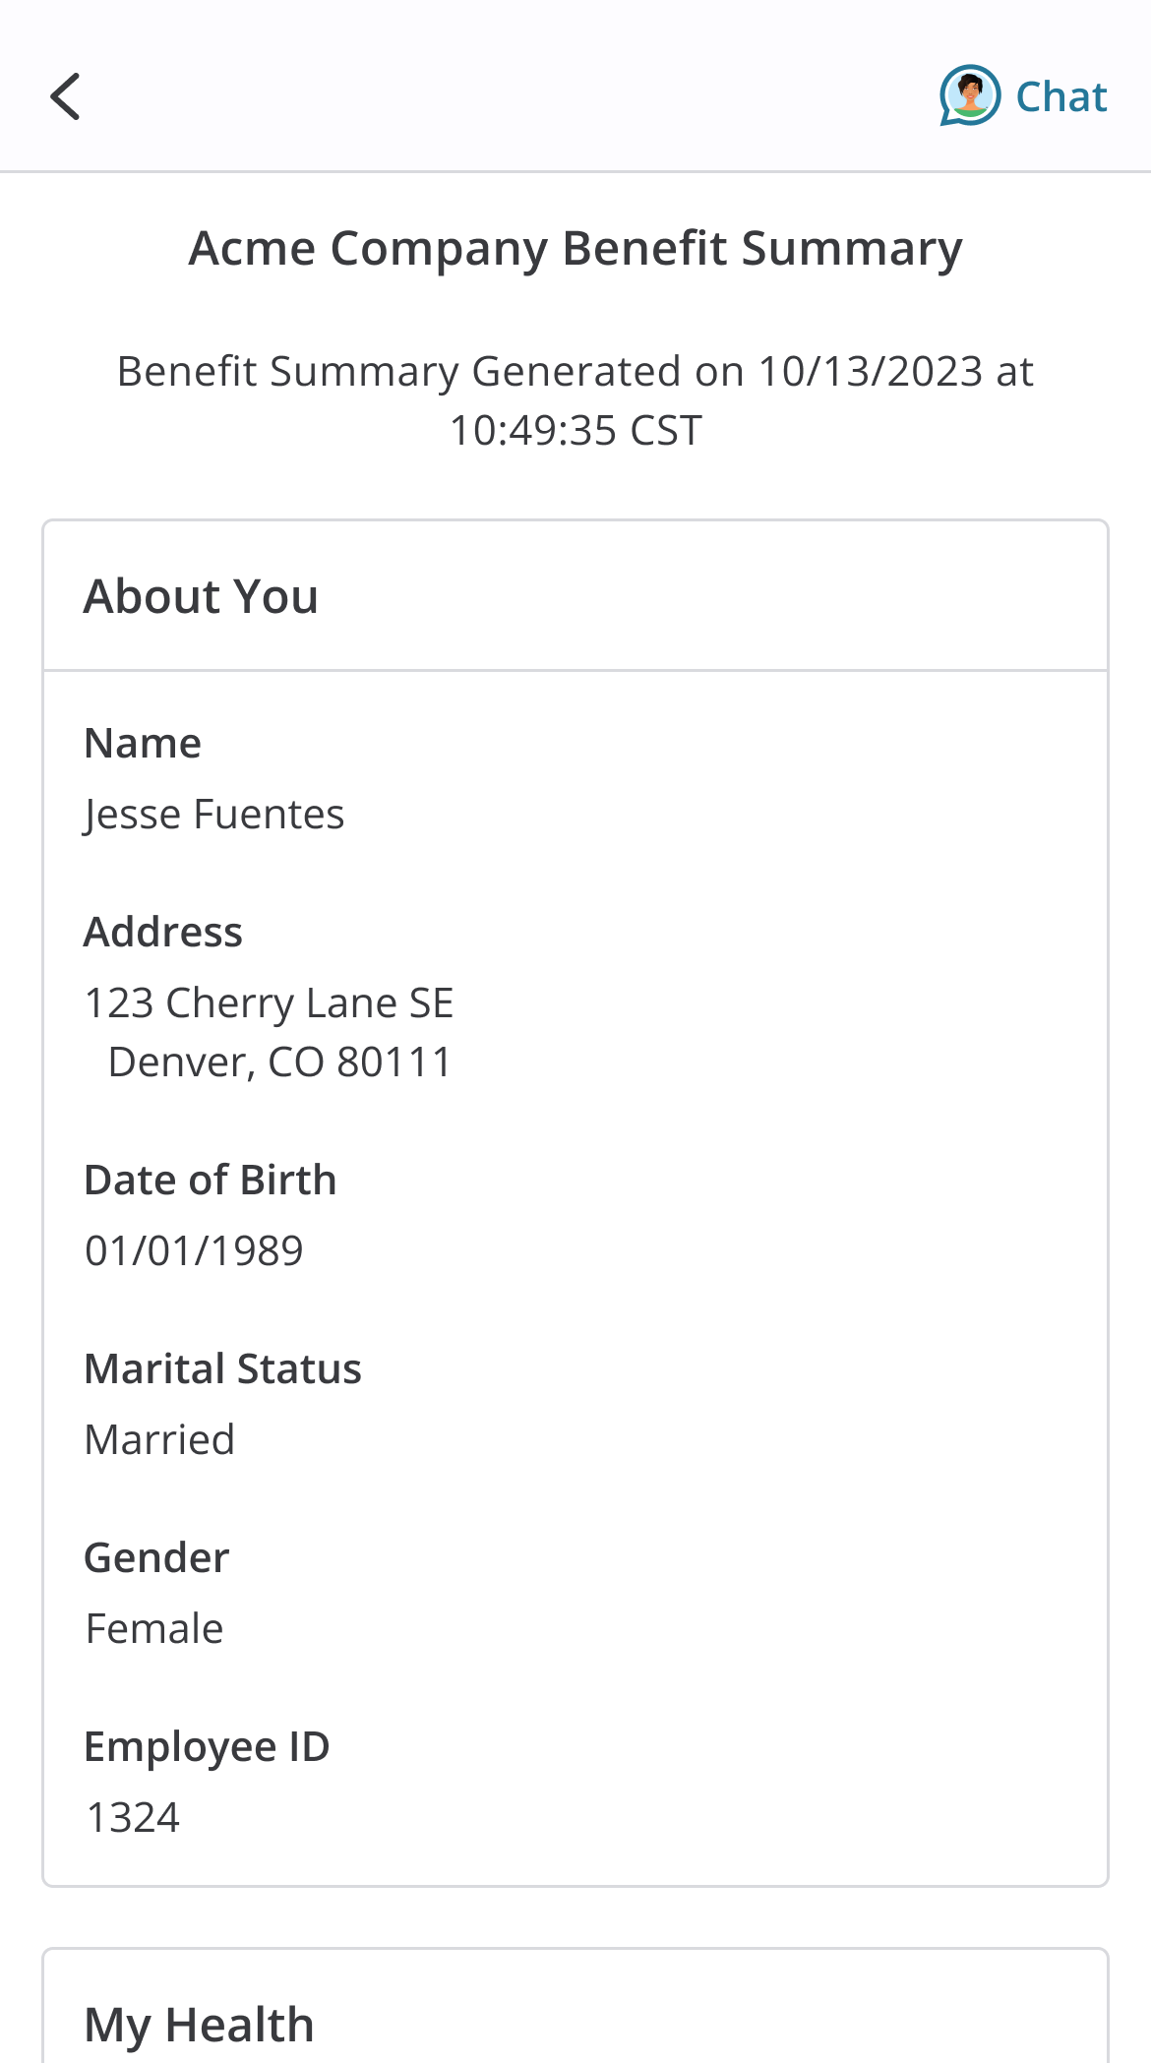
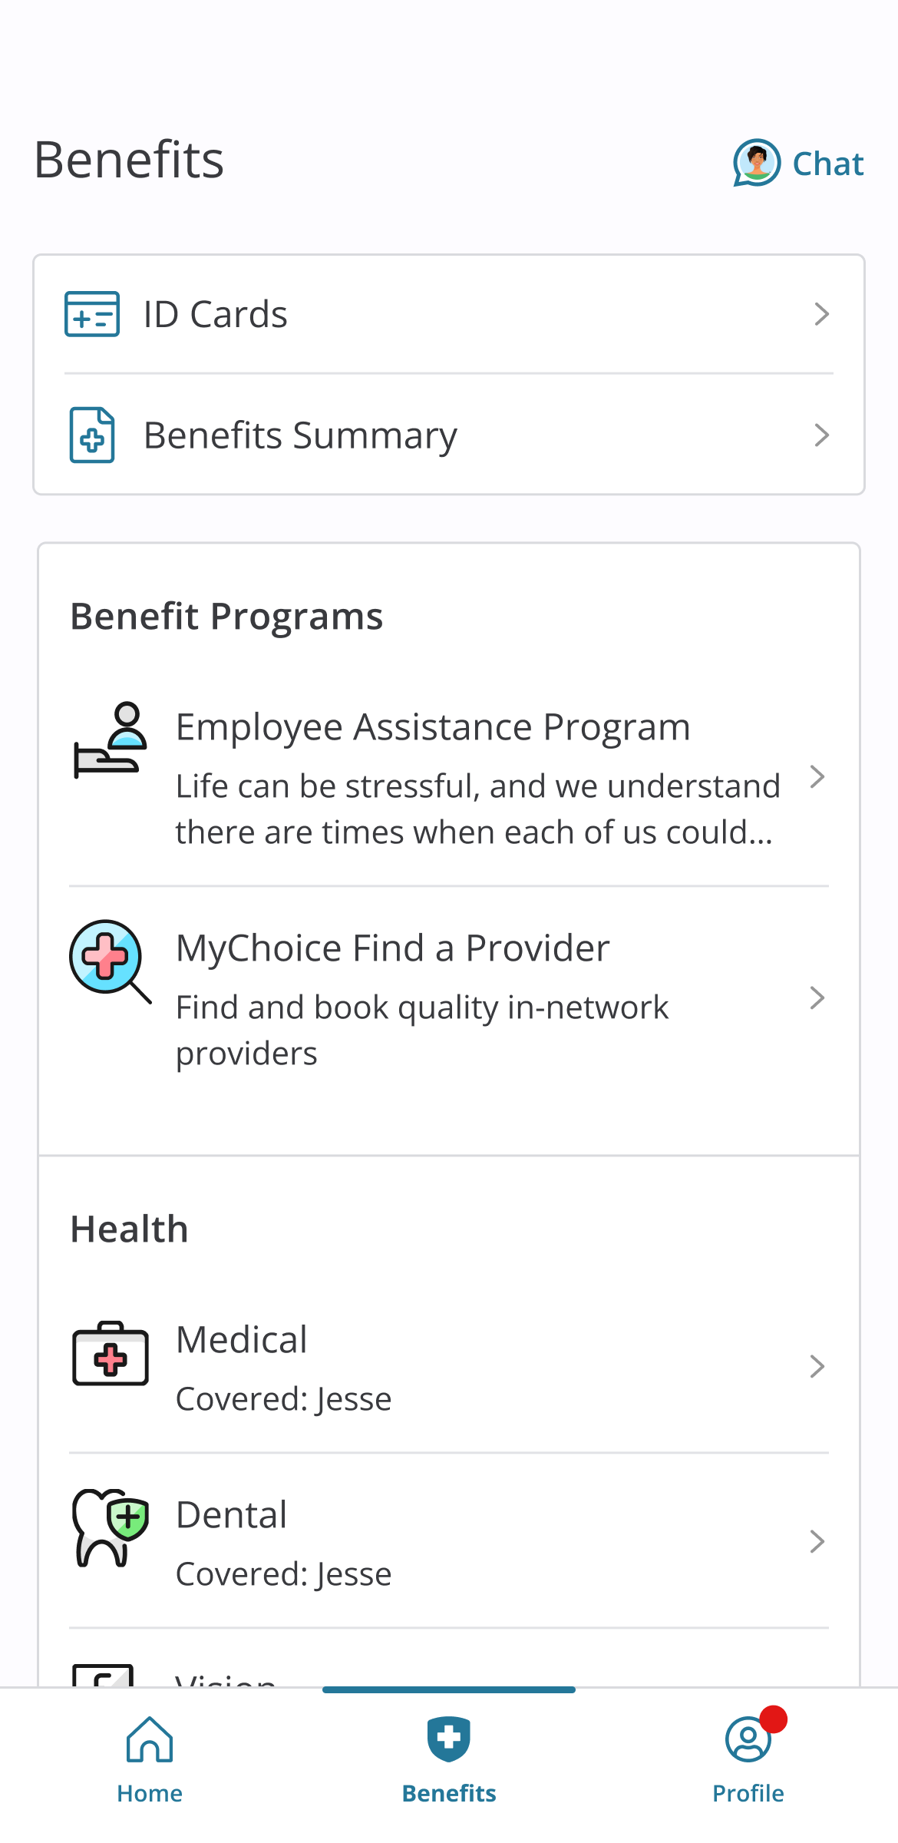
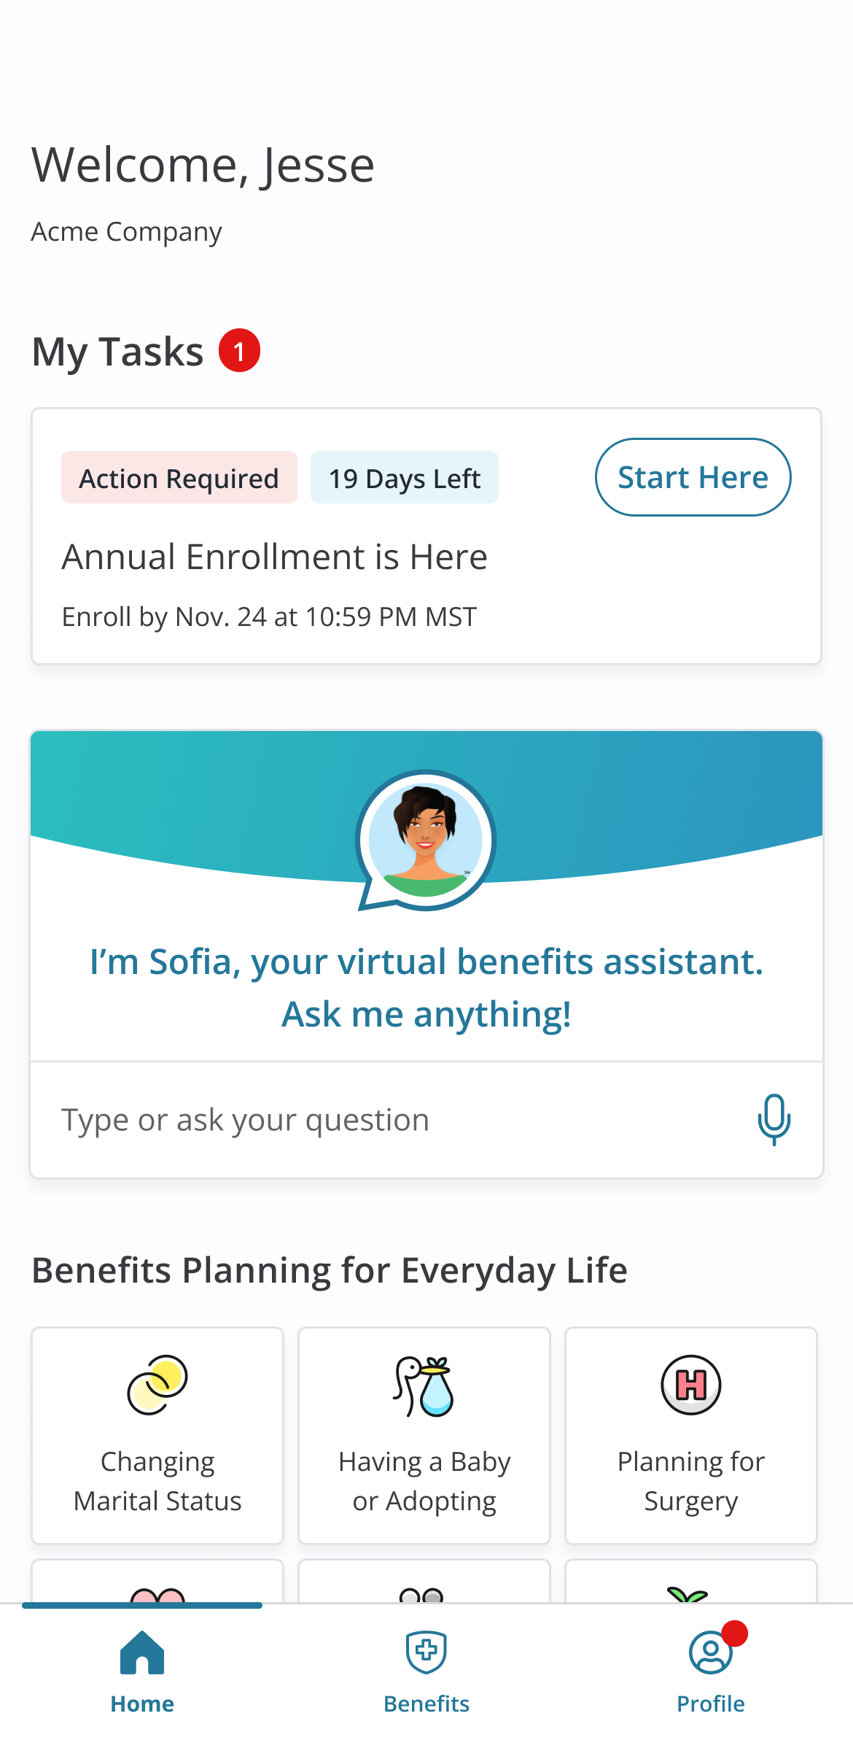
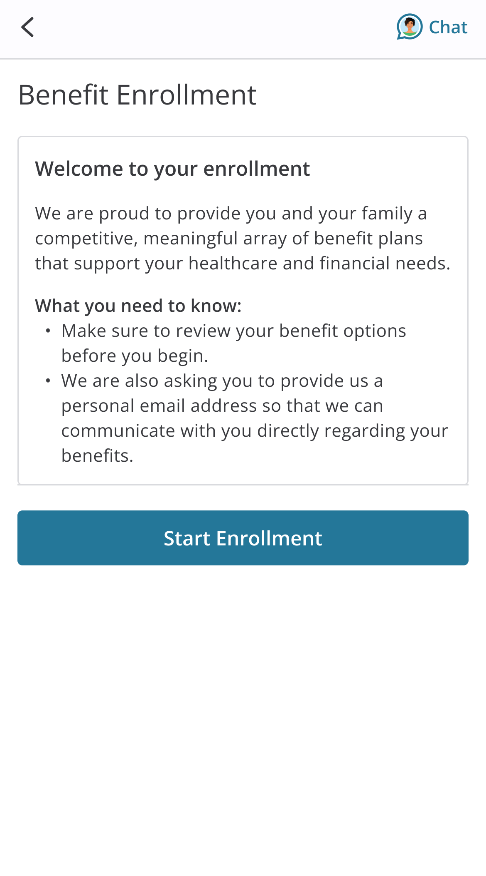
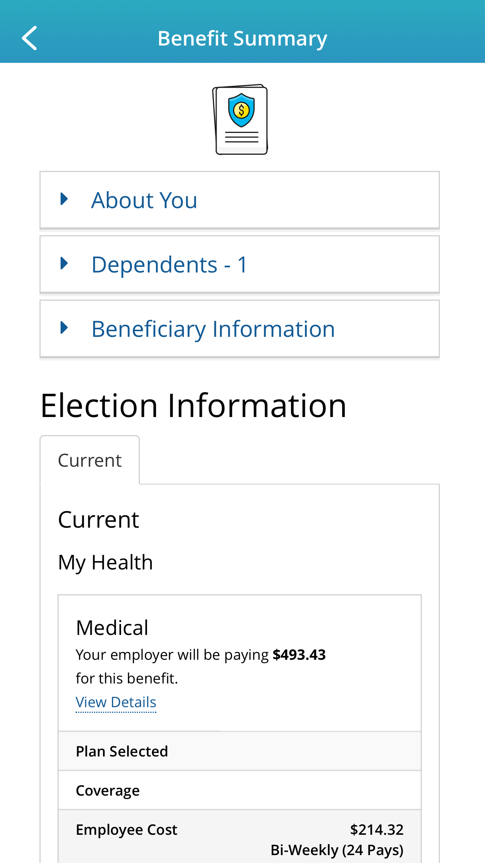
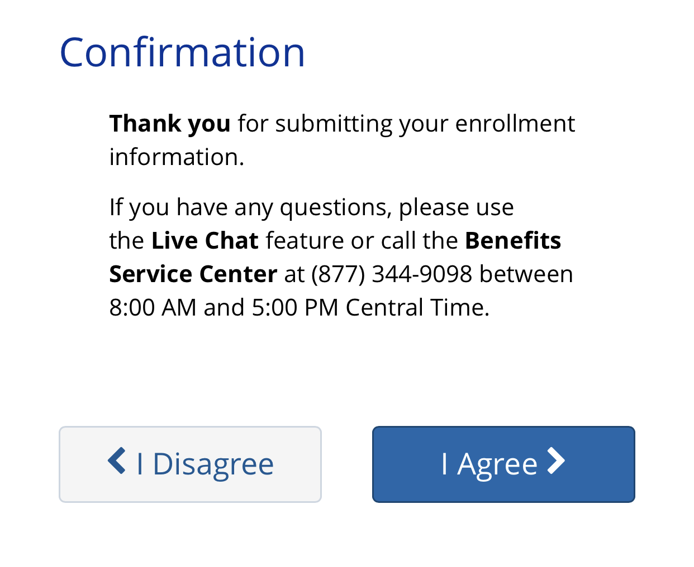
EXPLORE YOUR OPTIONS
Explore the Benefits tab to review your current coverage.
Find plan details in the Reference Center.
START YOUR ENROLLMENT
My Tasks will alert you that Annual Enrollment is available. Tap Start Here to begin.
Click the Start Enrollment button to review your personal information and add or edit any dependents you wish to cover.
If you are adding dependent(s) to your coverage, you will need to provide each dependent’s legal name, Social Security number, and birth date.*
*You may be required to provide documentation to prove your relationship to each dependent.
ENROLL IN COVERAGE
Use the Next and Back buttons to review and elect options available to you. Choose or decline coverage for each option and select which family members you want to cover.
Review plan documents and use the Compare and Plan Details tools to view details and costs for the options available to you.
REVIEW AND FINALIZE YOUR ELECTIONS
Make sure your personal information, elections, dependents, and beneficiaries are accurate, then Approve your elections.
To finish, click I Agree. When your enrollment is complete, you will receive a confirmation number and can review your Benefit Summary.
AFTER YOU ENROLL
Return to the Home page to check for any additional tasks needed to complete your enrollment.
Scan the code to download the MyChoice benefits app to your device today!

